Slide 1

The Importance of Communications
Andrew Smith, Director of Communications
Notes:
Sept. 20, 2023
ANS Local Section of San Diego

Slide 2
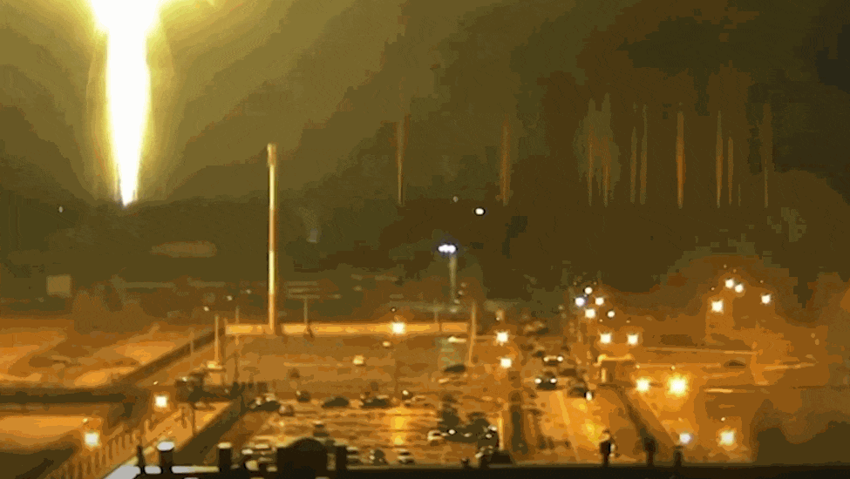

Slide 3

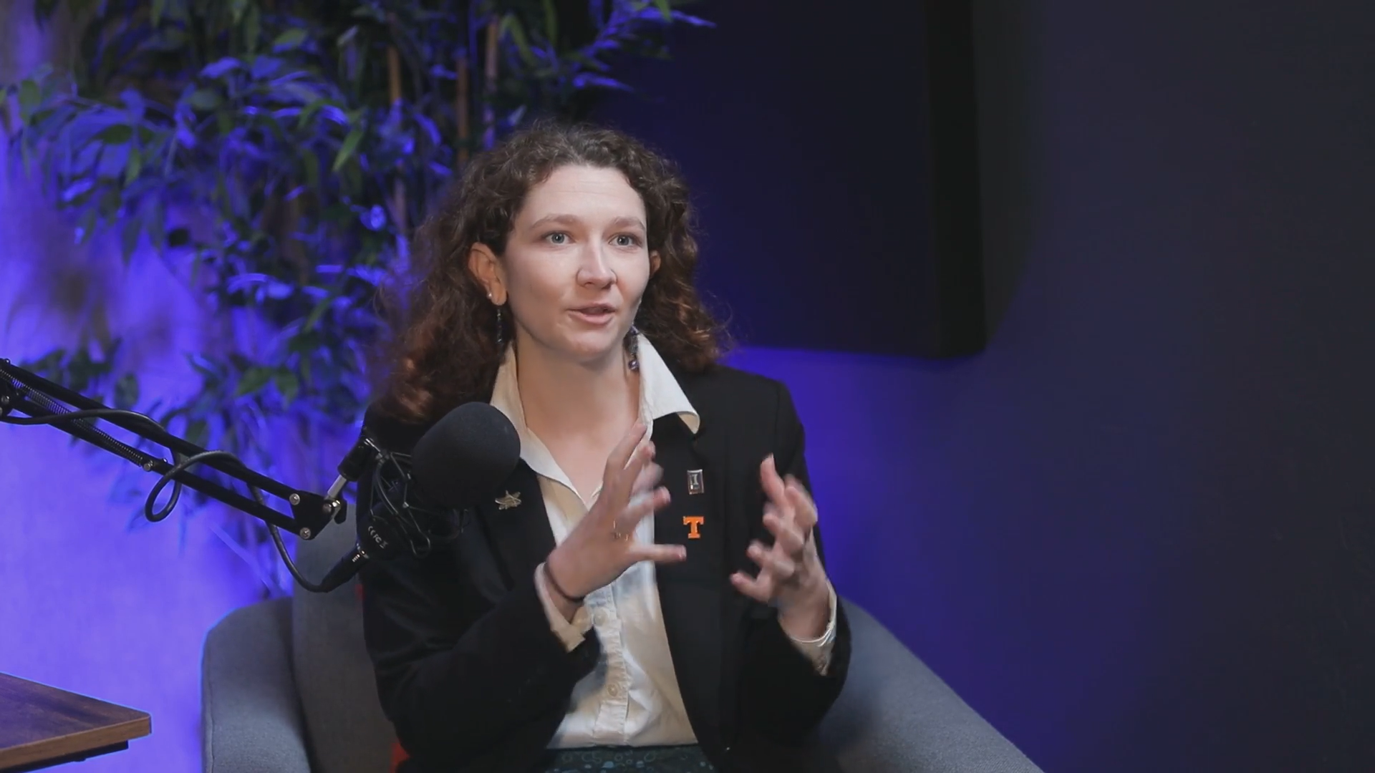
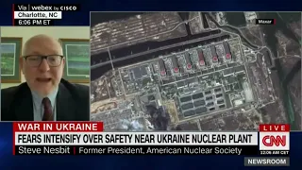
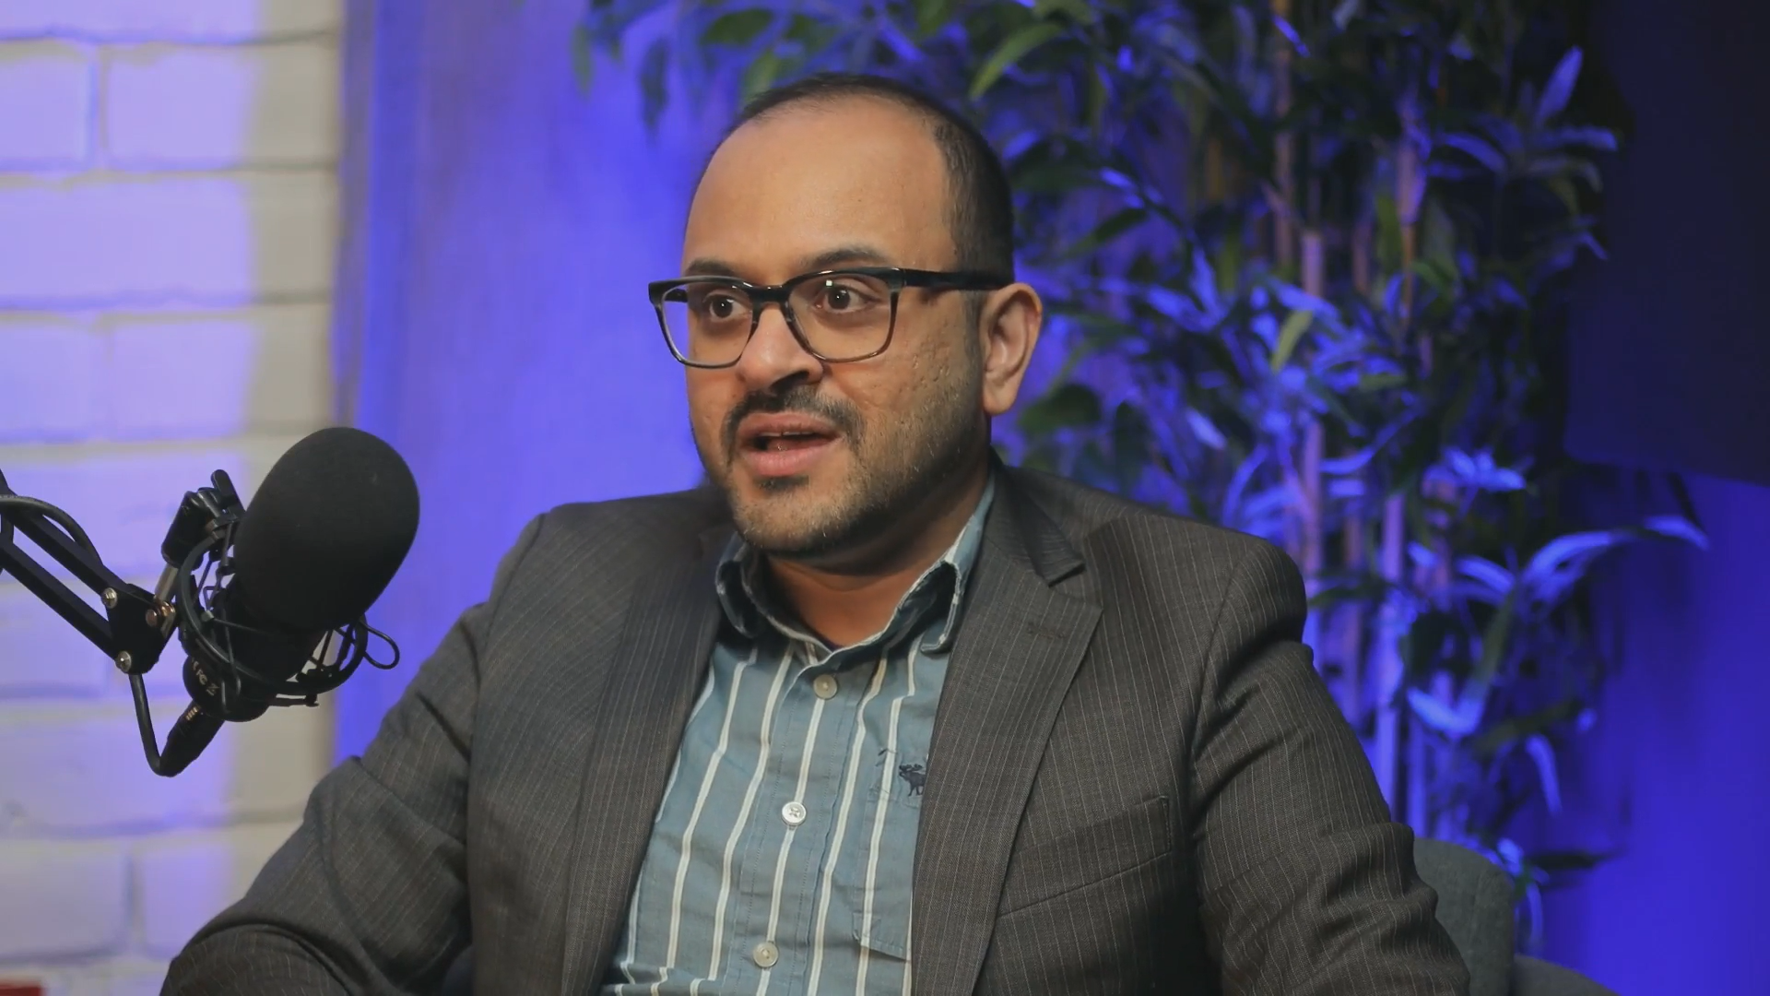
Trusted voice of independent experts

Slide 4
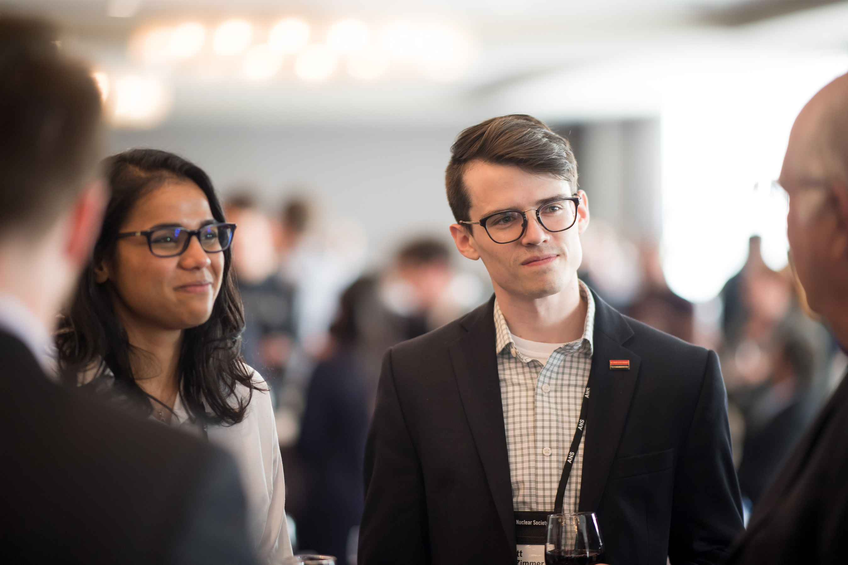
Trustees of Nuclear support media-training experts to shape the narrative and combat misinformation when nuclear is in the news.
Trusted, independent voice
Meeting the need for a diverse set of media-trained nuclear experts
Prepared for a wide range of events

Slide 5















Slide 6
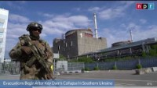

Slide 7
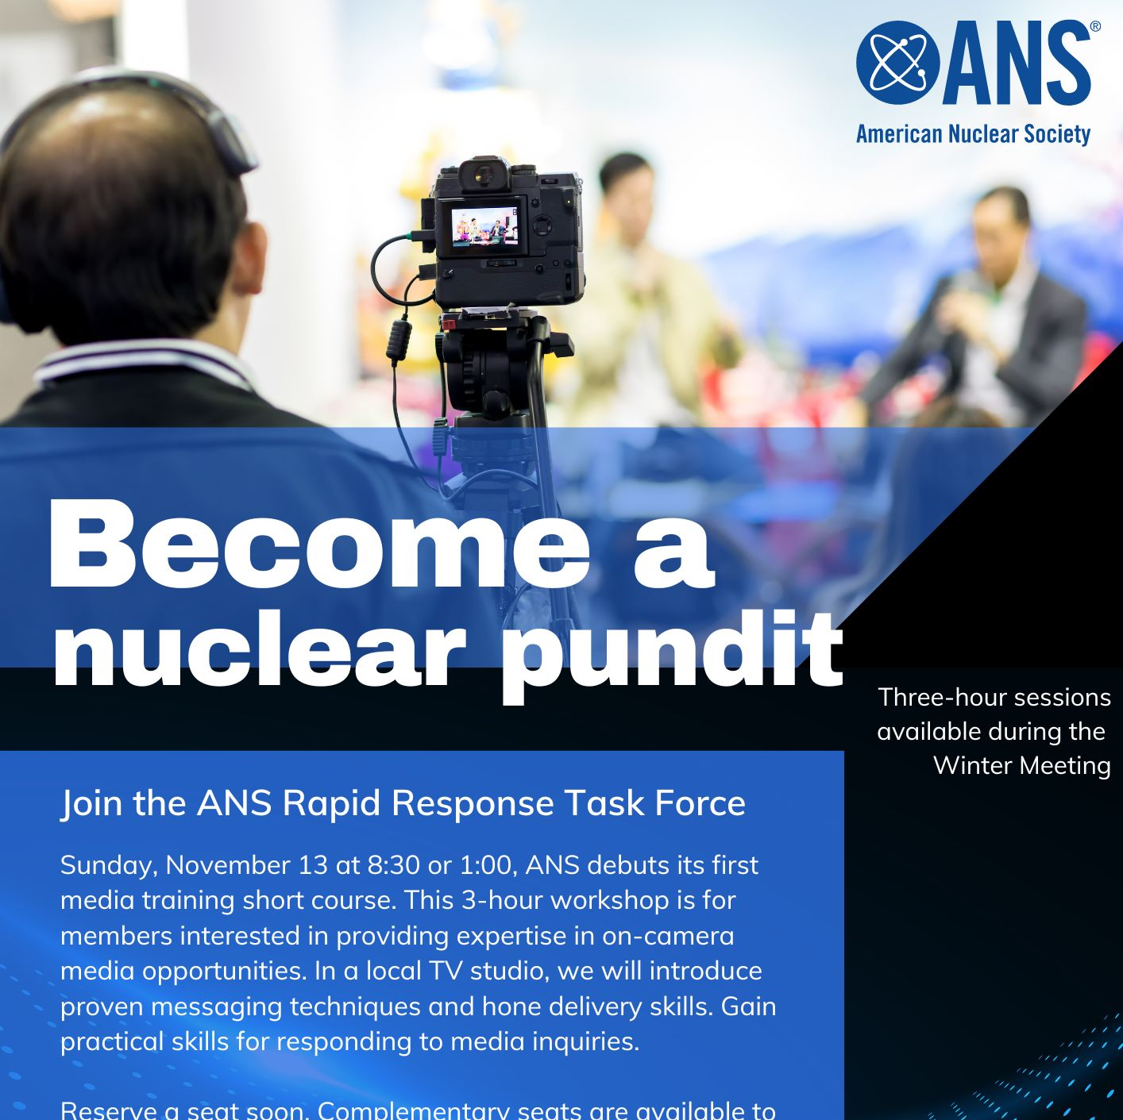
Media Training Workshops:
Equip experts with proven messaging techniques
In-studio experience and feedback to hone delivery
Crisis event scenarios
“Take home” recordings for later viewing

Slide 8
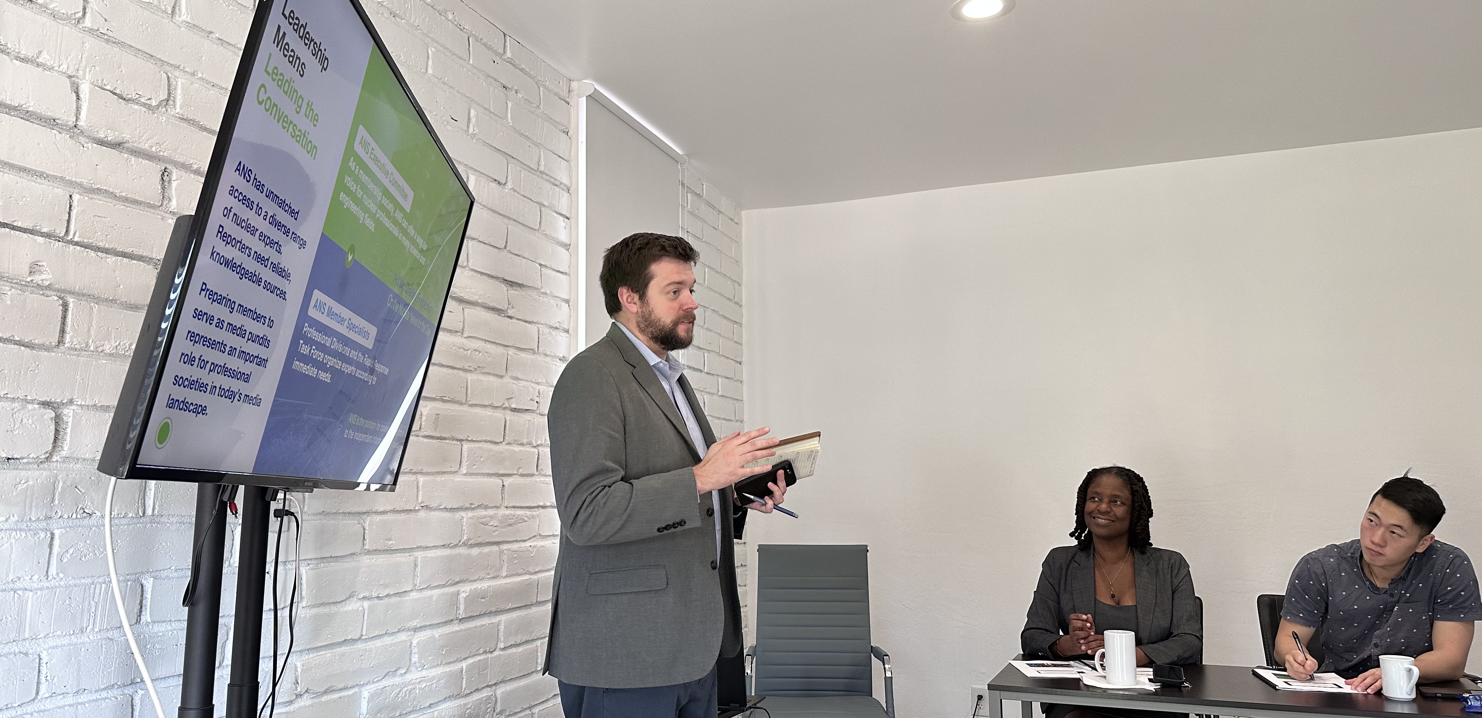
Media Training Workshop in November 2022 at the 2022 ANS Winter Meeting

Slide 9
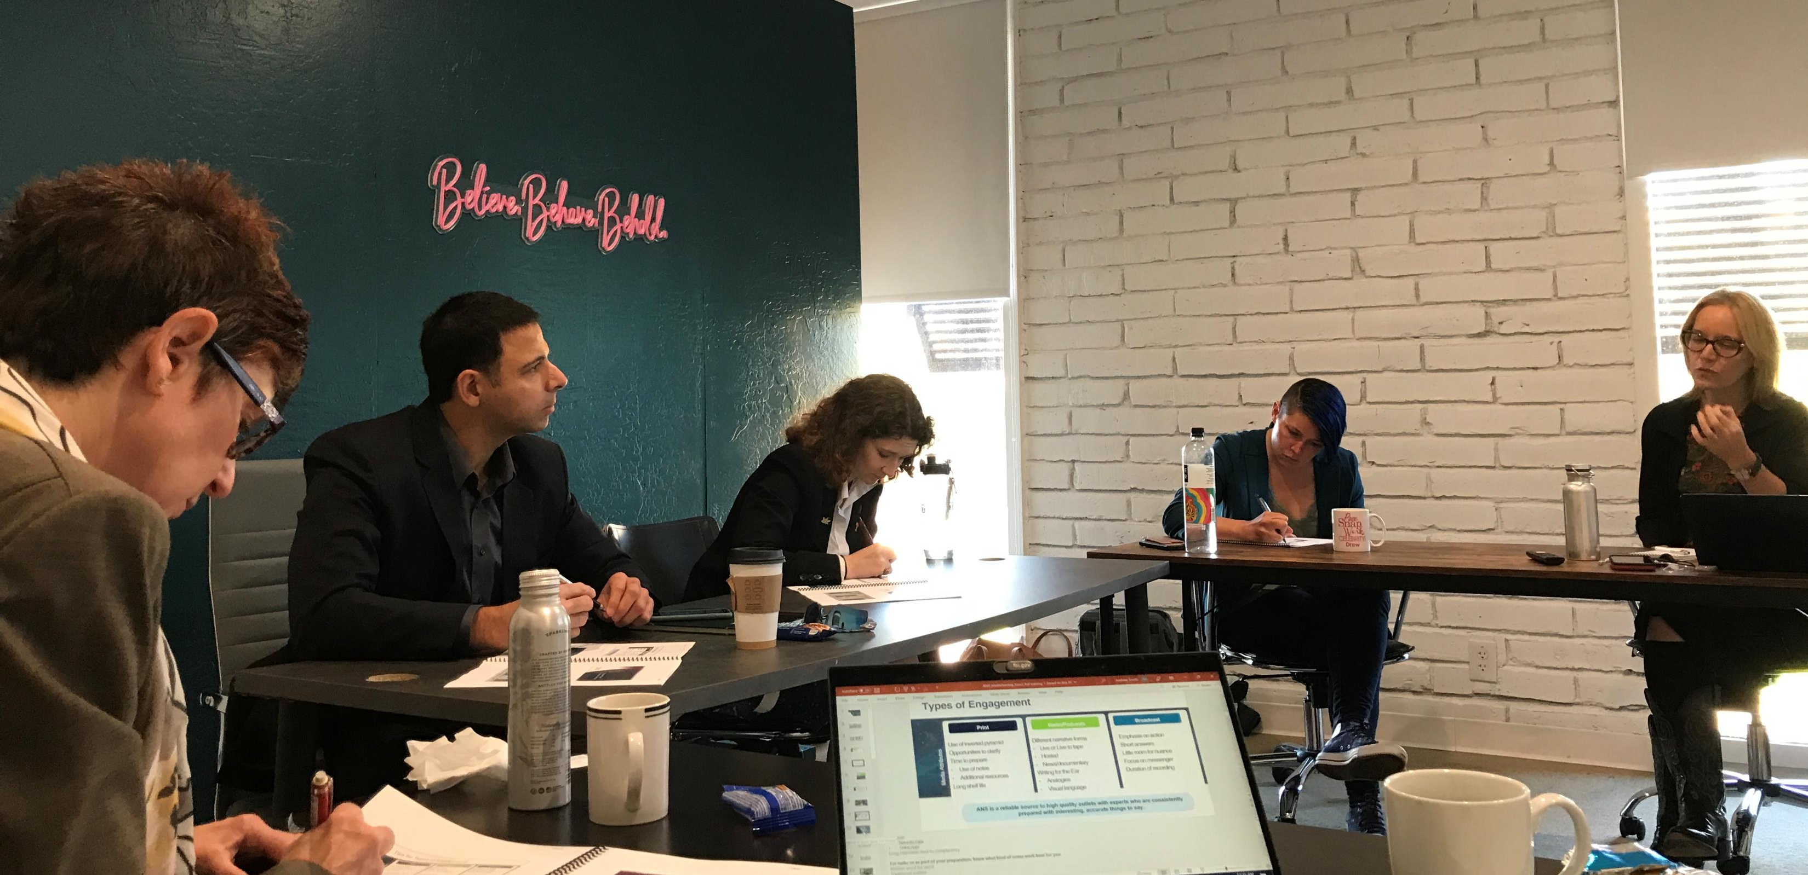
Media Training Workshop in November 2022 at the 2022 ANS Winter Meeting

Slide 10
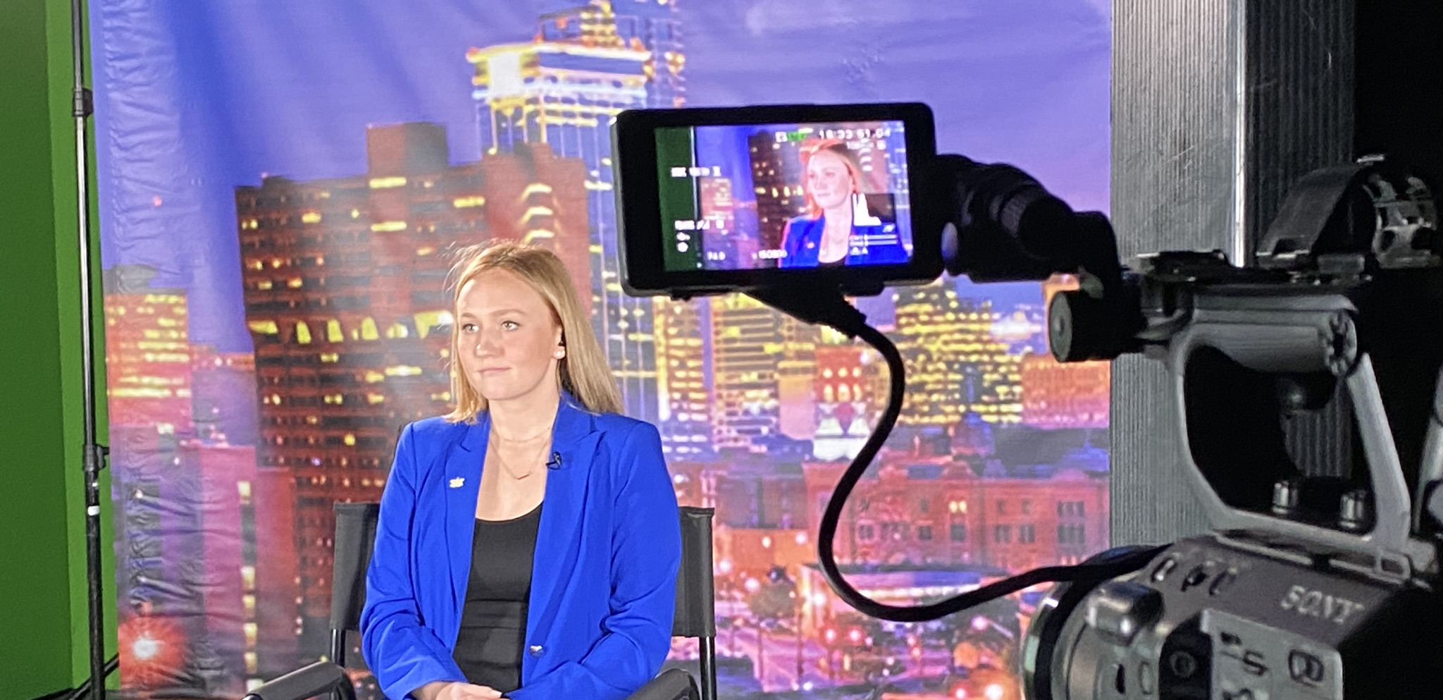
Media Training Workshop in June 2023 at the 2023 ANS Annual Meeting

Slide 11
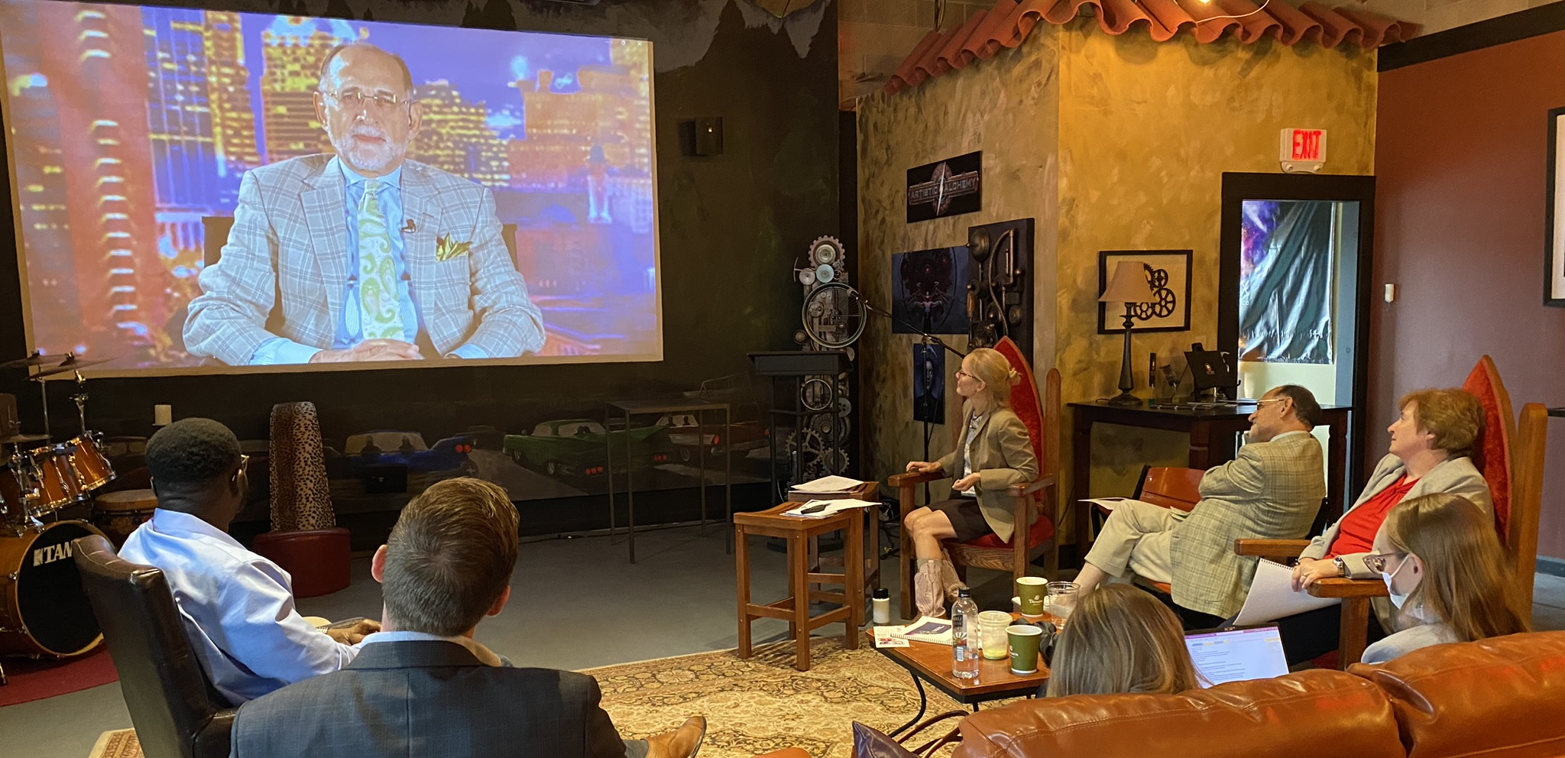
Media Training Workshop in June 2023 at the 2023 ANS Annual Meeting

Slide 12
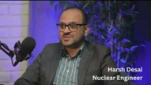

Slide 13

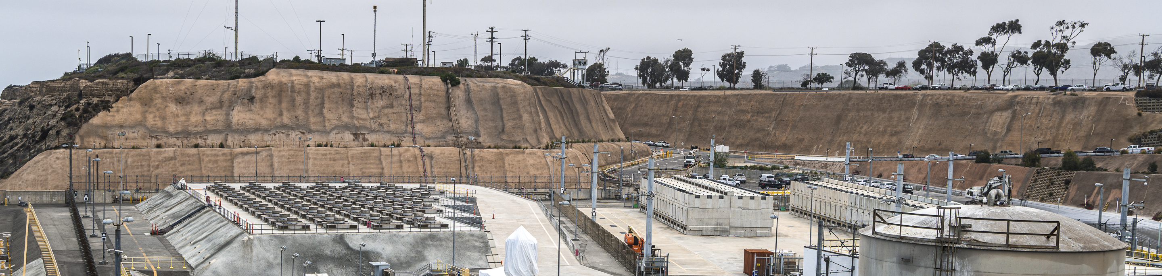
American Nuclear Society Partnership for
Asset-Based Collaboration
DOE's Consent-based Siting for
Interim Storage Program:
DE-FOA-0002575
Photo Credit: San Onofre
Notes:
Photo Credit: San Onofre

Slide 14




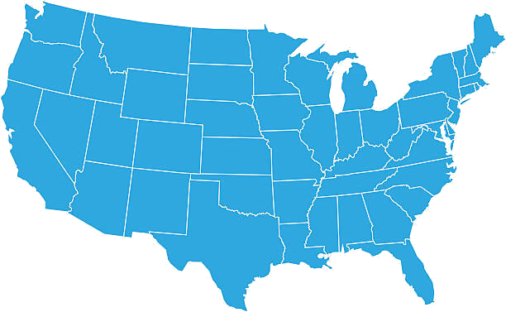



Founded in 1954, professional society of 10,000 nuclear science and technology professionals and university students
Thirty-five-year-old consortium supporting workforce development in STEM fields with extensive project management experience
Committed to becoming the largest university serving Native American/Indigenous communities
Serving Hispanic American and rural communities; host of the only nuclear engineering program at a predominantly Hispanic-serving university
Historically black, land-grant university serving African American and rural communities; host of the only nuclear engineering program at a historically black university
Harlem-based college serving a diverse urban community
Consortium:
ANS joins the South Carolina Universities Research and Education Foundation (SCUREF) to work with four Minority Serving Institutions to identify stakeholder strengths and expectations for nuclear materials management and resource needs to improve the country’s outlook for nuclear waste solutions.
Notes:
Demonstrated in Illinois, New Mexico, and California, independent citizens have reached out to ANS to deliver relevant nuclear-related information to their communities. Individual actors built new relationships with ANS members and grew support within their local organizations, resulting in the types of successes characterized in the letters of support attached to this proposal.
While social capital is no replacement to address the structural causes of inequality, Asset-Based Collaboration provides participatory appraisals in an iterative process to tackle the definition of a consent-based process for the siting of consolidated interim storage
ANS joins forces with the South Carolina Universities Research and Education Foundation (SCUREF) to work with four MSIs to identify strengths of local decision-making practices and expectations for nuclear materials management and resource needs to improve the country’s outlook for nuclear waste solutions. We are working together to draw upon our team’s rich history of public engagement and communication as well as a membership base of nuclear
professionals and university students.
Asset-Based Collaboration (ABC) for Effective Engagement in Consent- Based Siting (TITLE OF PROPOSAL)
Our approach employs an asset-based community development approach leading to a replicable process for community engagement related to consent-based siting. Expanding a national dialogue on the future of nuclear materials transportation and interim storage in the United States starts locally—from community to community, neighbor to neighbor.
Building a groundswell of understanding for as complex and charged an issue as the transport and interim storage of spent nuclear fuel and waste takes a sound community engagement methodology and a diverse set of partners, each with a specific and important role to play.
Develop a replicable, scalable model of community engagement that invites individuals and
organizations from target communities—specifically those under resourced and with
underrepresented and diverse populations—to a mutually respectful, productive, and accessible
dialogue around consent-based siting.
Build effective, sustainable collaboration between partners, including ANS, the DOE,
SCUREF, MSIs, and community stakeholders, citizens, and elected officials. The partnerships
lead to the formation of the Collaboration Hub, fostering dialogue, sharing resources and
information, and finding common ground among multiple voices.
Cocreate community-driven solutions to consent-based siting, addressing management of
spent nuclear fuel, interim storage, siting considerations, and the role a federal consolidated

Slide 15






Areas of Engagement
Asset mapping allows the ANS partners to assess by geography and by constituent groups.
Asset-Based Collaboration provides participatory appraisals in an iterative process to tackle the definition of a consent-based process for the siting of consolidated interim storage
Letters of Support for ANS proposal (left) showcase examples of labor, professional, tribal, and faith-based communities and civic organizations
Notes:
IBEW
Health Physics Society
Episcopal Diocese of Chicago
League of Women Voters of New Mexico
Energy Communities Alliance
The ytt Northern Chumash Tribe of SLO County and Region

Slide 16
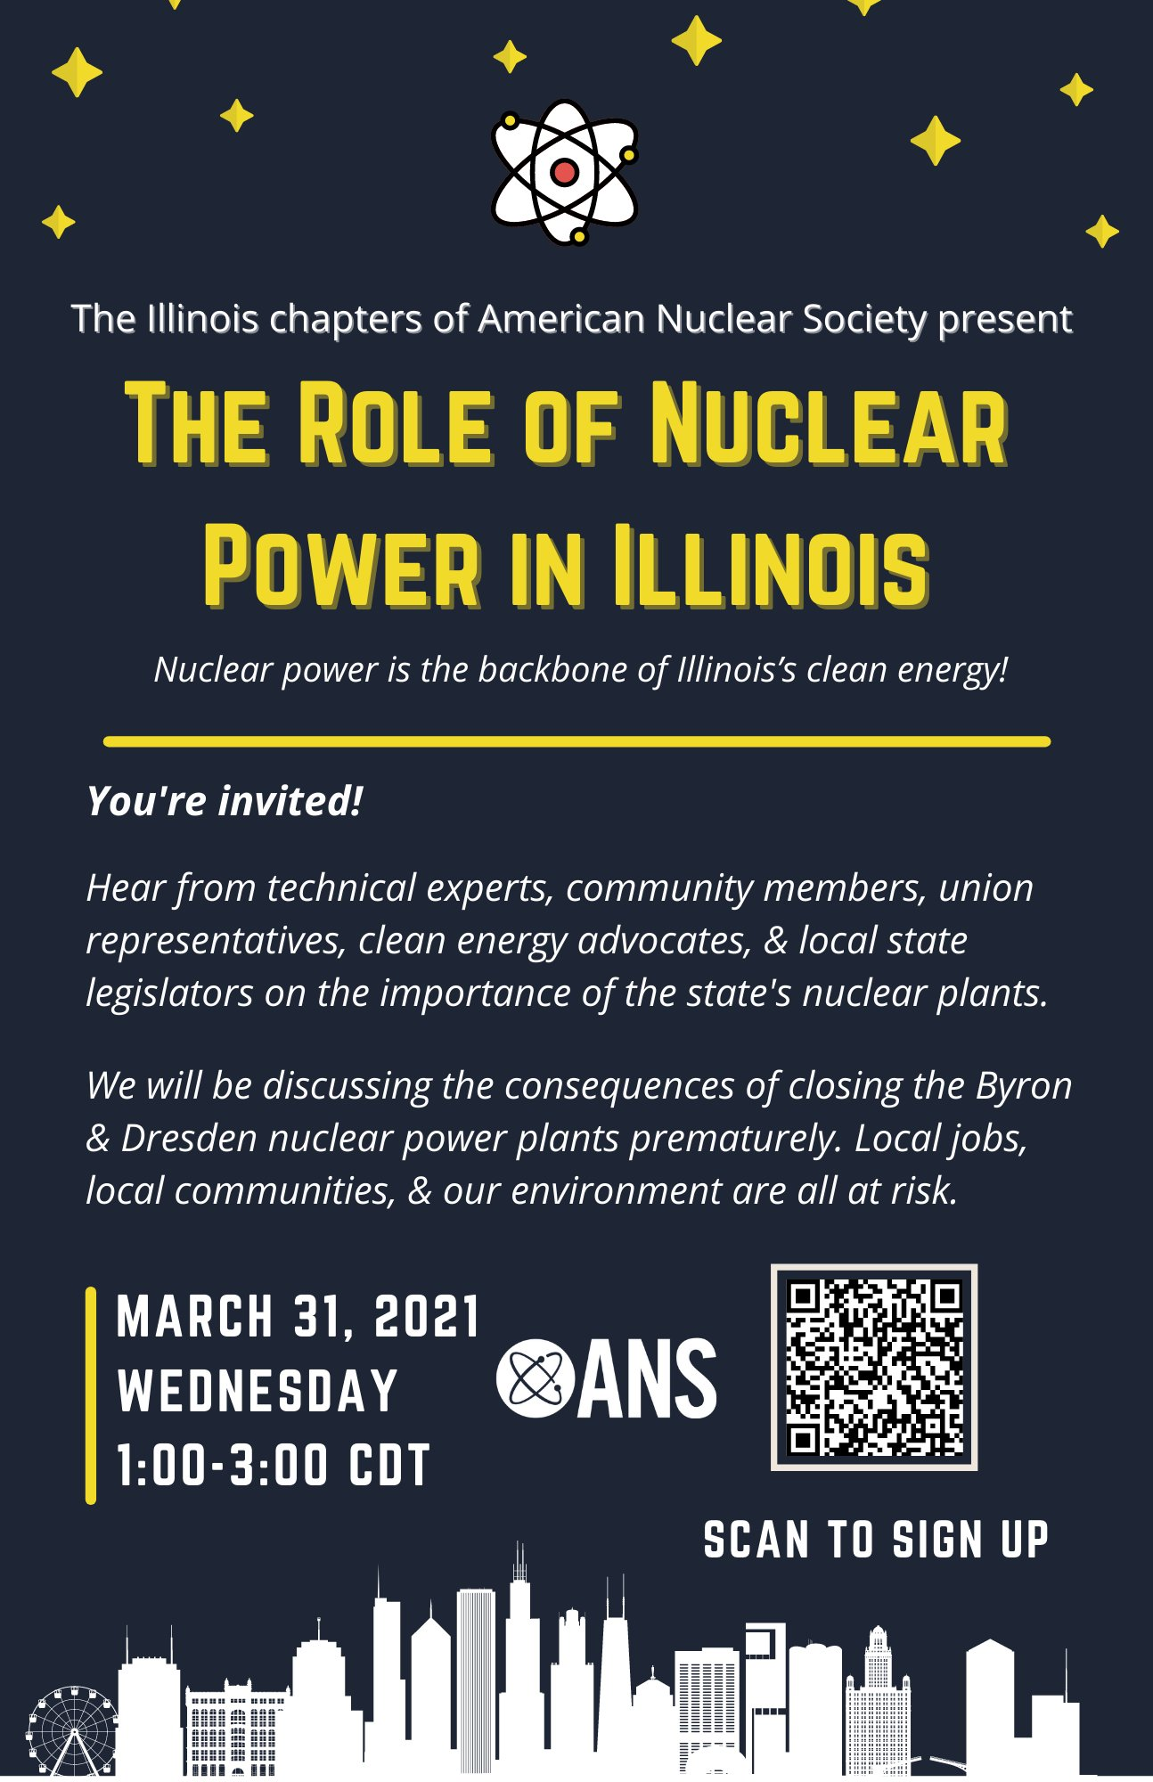
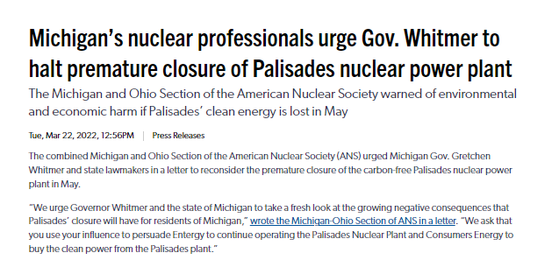
Local Section ideas
In-person and Virtual Events, featuring nuclear AND non-nuclear speakers
  Invite media and elected officials!
  Brownie deficit
Letters to the Editors and OpEds in local newspapers
Letters to decisionmakers (offer expert analysis if x action is taken or not)
Notes:
Examples of Local Section activities

Slide 17

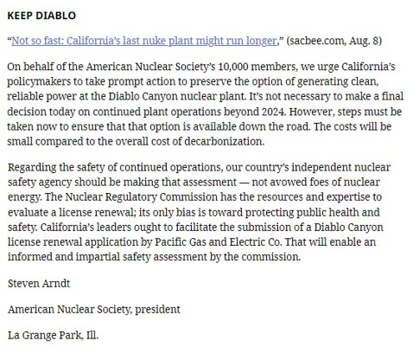
Insert nuclear into the local news cycle
Letters to the Editor
  Responses to previous OpEds or news stories
  Sharp, 150 words or less
Opinion Editorials (OpEds)
  Proactive
  Longer, 700-750 words in length
Look to ANS “National” for guidance on tone, word choice, stance, etc.:
Position Statements -- ANS / Public Policy
Letters and Comments -- ANS / Public Policy
Press Releases: Media -- ANS / About ANS
ANS OpEds and Letters to the Editor (right)
Notes:
Word lengths are from local San Diego newspaper

Slide 18
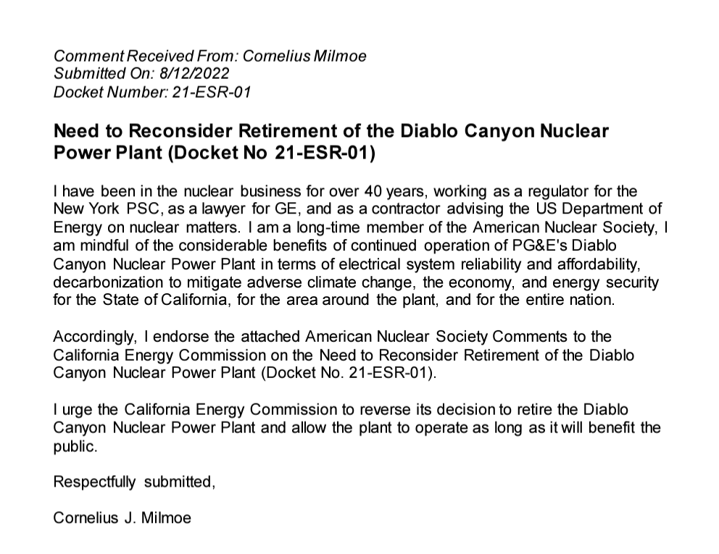
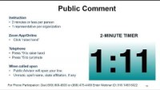
Commenting at state agencies, ISOs, etc.
Notes:
California joint-agency townhall on the future of Diablo Canyon (Aug. 12, 2022):
ANS California members provided 70 written comments and testimonies at five-hour townhall after legislature passed S.B. 846
See examples above, right

Slide 19
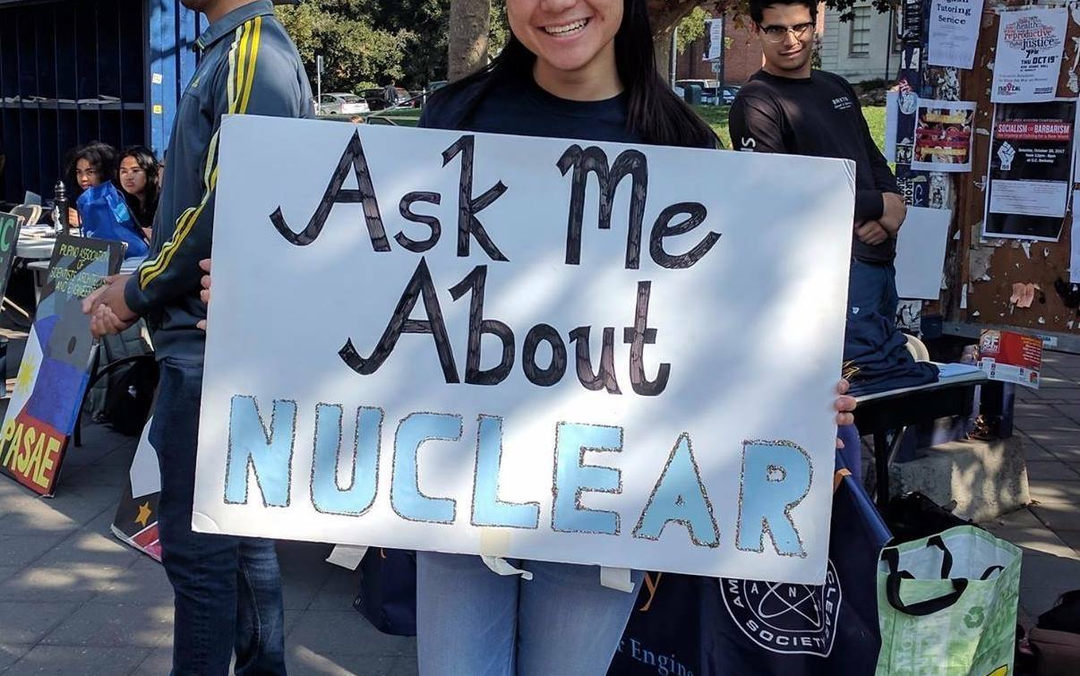
Offer your technical expertise!
Speak as yourself
Use your credentials
  Nuclear engineer, member of ANS, etc.
Avoid speculation
Give facts
Avoid jargon
OK to “follow up”
Point media to credible sources:
  ANS
  Regulators
  IAEA
  UNFCC

Slide 20

Out-green the anti-nukes
Emotions > logic
Perception is reality
Success comes from positivity
Third parties translate into higher credibility
Americans love storytellers, be compelling!
Energy density = big nuclear is actually small:
  For the environment, keep Indian Point open – New York Daily News (nydailynews.com)
  End the War on Nuclear Power—Start with Radiation (powermag.com)
Campaigning for Clean Air
• Support nuclear while simply sitting at your computer
• Support nuclear n public, using the same techniques as professional speakers and communicators
• Speak at a public hearing or be invited to speak to a legislative committee
• Learn how to deal with your own emotions
• Find other nuclear supporters and have fun together

Slide 21
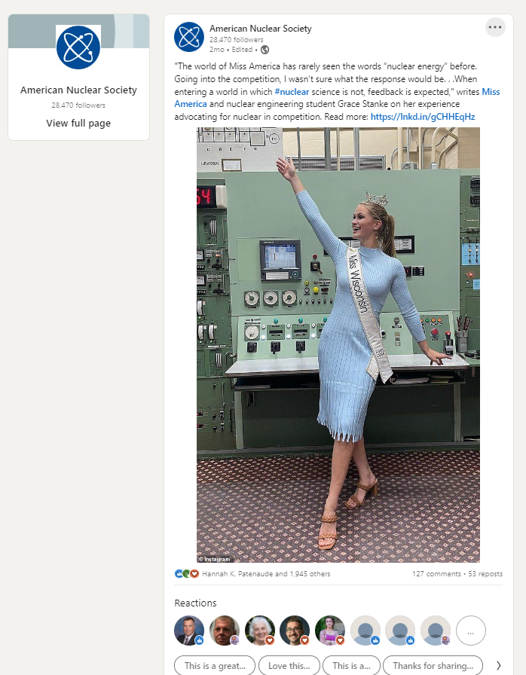
ANS Social Media in Post-Twitter:

Slide 22
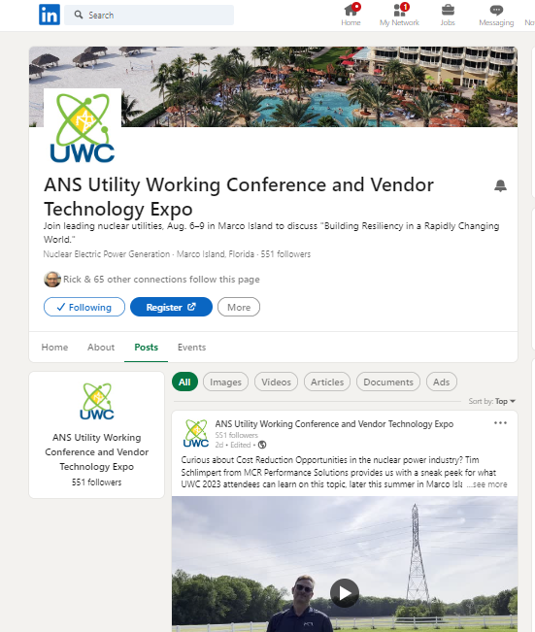


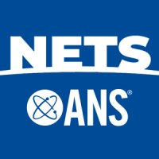
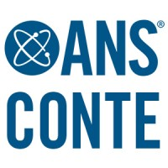
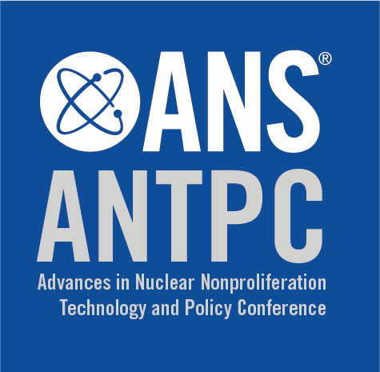
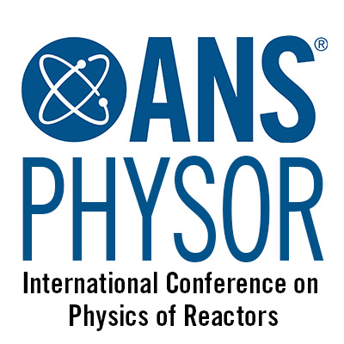



Showcase Pages
New dedicated pages for ANS Topical Meetings
Organizer-run with ANS admin oversight

Slide 23
THANK YOU
Andrew Smith
asmith@ans.org
www.ans.org

