Slide 1
Presentation to the San Diego Local Section

Slide 2
How ANS is Advancing Nuclear Science
and Technology and How You Can Help
Steven A. Arndt, PhD, PE
President, American Nuclear Society
Distinguished Scientist, Oak Ridge National Laboratory
March 15, 2023

Slide 3
Agenda
American Nuclear Society highlights
Nuclear power
Advocacy for nuclear science and technology and how the San Diego Local Section can help

Slide 4
ANS Highlights

Slide 5
ANS Vision
Nuclear technology is embraced for its vital contributions to improving peoples’ lives and preserving our planet.
ANS Mission
Advance, foster, and spur the development and application of nuclear science, engineering, and technology to benefit society.
Notes:
Important to remind ourselves that ANS exists for a purpose.
Our activities should work toward that purpose.

Slide 6
2023 outlook: PROMISING!
Last years NETS, PHYSOR, Annual, UWC, TopFuel and Winter meetings finished ahead of projections in attendance and sponsorship
2023 has a lot of interesting meetings including: CONTE, NETS, Annual, PSA, NPIC&HMIT, M&C 2023, NURETH-20 and others
Student members up 30% in 3 yrs.
New programs (Trustees of Nuclear, Navigating Nuclear 2.0, Publications, etc.)

Slide 7
Keeping members informed
Free access to all journals
Updated Nuclear News (refresh in July 2022)
ANS Nuclear Smartbrief
Daily email with nuclear news (www2.smartbrief.com)
ANS Newswire (on ANS website)
Notes:
More explicit about what motivated the change plan, chart with revenue vs expenditures, provide evidence of reason for change, including decreasing membership, back up slide on 1ANS (what do successful societies do about membership?),

Slide 8
Publications—Overview
Newswire
Magazines
Nuclear News
Radwaste Solutions
Technical Journals
Nuclear Science and Engineering
Nuclear Technology
Fusion Science and Technology
Nuclear Science and Technology Open Research
Standards / Nuclear Standards News
Books
Meeting publications (Transactions and proceedings)
Newswire—Over 4,000 articles on Newswire since April ’20, averaging over 80k views per month in 2022.
Magazines—1,700 pages published this year; nearly 1,000 issues published with over 100k pages in the ANS archive.
Journals—Impact factors and submissions continue growth trend; over 30K articles in archive.
New OA platform to launch Q1 2023.
Standards—88 current standards with 3 standards approved in ’21 and 7 in ’22.
Books—1 book published in ’21, 3 currently in the production.
Meeting publications—jointly between Meetings and Pubs over 1,200 papers published in ’21, over 1,600 in ’22; nearly 20K article in archive.

Slide 9
Nuclear Science and Technology Open Research
Hosted by F1000—a subsidiary of Taylor & Francis
To be launched Q1 2023
Will feature gateways for each professional division
ANS members will receive a discount on the Article Processing Charge
$100k donation from an ANS member will cover the setup costs

Slide 10
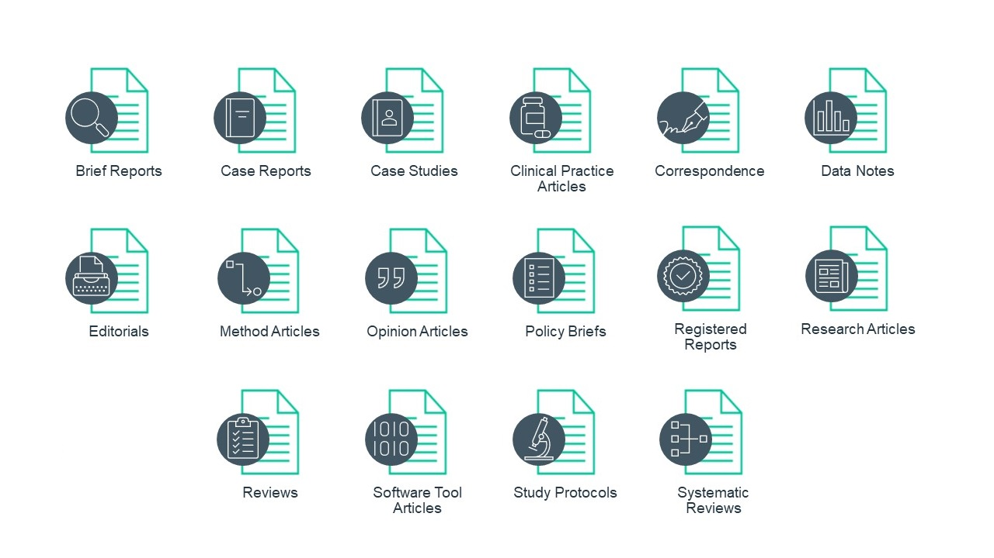
Introduction to the F1000 platform
Launched in 2013 initially only covering life sciences, but now expanding to cover all disciplines
Rapid dissemination of research, improved transparency and reproducibility, and removing editorial barriers to publishing
All types of research can be published rapidly e.g. traditional articles, data sets, null results, protocols, policy briefs

Slide 11
Launching the Platform
Next Steps (Q1 2023)
Establish an expert advisory board of leading and emerging researchers
Advisors to provide input on initial strategy and help to promote the Platform launch
Launch and nurture thematic Collections which align with the scope of the Platform
Encourage advisors and colleagues to publish content with us during the launch phase

Slide 12
Representing members to non-nuclear communities
Crisis communications/Rapid Response capability
ANS Special Committee on Generic Standards for the Disposal of High-Level Radioactive Waste
Engagement with new Congress and Presidential administration in 2023
Nuclear in Every Classroom campaign

Slide 13
Rapid Response Taskforce
Shaping the narrative; combatting misinformation.
Prepared for a wide spectrum of nuclear or radiation-related events or emergencies
30+ independent technical professionals in diverse nuclear fields
Online media help center for journalists

Slide 14
News Coverage
Diablo Canyon
Federal Policy
Zaporizhzhia
The New York Times – Aug. 23
S&P Global – Aug. 3
The Washington Post – Aug. 6
“The American Nuclear Society’s convention, held for four days in the shadow of Mickey Mouse, couldn’t have picked a better venue to uplift spirits.”
“[A] full five-member commission is essential to the effectiveness of the NRC in protecting public health and safety while enabling the deployment and applications of new nuclear technologies.“ – Steven Arndt & Craig Piercy
“It is unjustifiable for a civil nuclear facility to be used as a military base or be targeted in a military operation.”
– Steven Arndt & Craig Piercy

Slide 15
News Coverage
Zaporizhzhia
Zaporizhzhia
Zaporizhzhia
CNN – Aug. 20
The Telegraph – Aug. 25
BBC – Aug. 25
Interview of ANS Immediate Past President Steven Nesbit
A spokesman for the American Nuclear Society [said] that these are all very unlikely situations, and that even in the “extremely unlikely scenario of a radiological release” there is no threat to the public as the amount of radiation released would be minimal compared to Chernobyl.
Interview of ANS Rapid Response Taskforce member and Lightbridge Corp. CEO Seth Grae

Slide 16
News Coverage
Zaporizhzhia
Zaporizhzhia
Ukraine
Associated Press – Sept. 12
NPR – Sept. 9
Newsweek – Oct. 7
“A cold shutdown enormously reduces the meltdown risk… Every hour that goes forward, the possibility of a meltdown of fuel becomes less and less.” – Steven Arndt
Even in the worst case scenario, the reactors at Zaporizhzhia are a modern design surrounded by a heavy "containment" building, Nesbit says. "It's reinforced concrete, typically about three to four feet of that; it's designed to withstand very high internal pressures.“ That could allow it to hold in any radioactive material.
.
"France [and Ukraine are] well suited because of their large nuclear content," Arndt said. "I think it's going to be a long hard winter all over Europe, including Ukraine. Any lack of industrial facilities is going to be a challenge."

Slide 17
Draft Recommendations for New Generic Environmental Standards for the Disposal of High-Level Waste
Current generic disposal regulation 40 CFR part 191
Out-of-date
In many cases inconsistent with the international state-of-the-practice
Modern, transparent standards needed to support potential efforts to site and license a geologic disposal facility other than Yucca Mountain
ANS Special Committee on Generic Standards for Disposal of High-Level Radioactive Waste established in 2021
Draft report issued February 17, 2023
Notes:
More explicit about what motivated the change plan, chart with revenue vs expenditures, provide evidence of reason for change, including decreasing membership, back up slide on 1ANS (what do successful societies do about membership?),

Slide 18
ANS Special Committee on Generic Standards for the Disposal of High-Level Radioactive Waste
Purpose to develop technical bases for updated generic public health and safety standards for disposal of used fuel and high-level radioactive waste
Purpose consistent with recommendations from the Blue Ribbon Commission on America’s Future (BRC 2012), American Nuclear Society (ANS 2020), the National Academies of Science, Engineering and Medicine (NASEM 2022), and others
Final report in summer 2023 after consideration of input from stakeholders
Notes:
More explicit about what motivated the change plan, chart with revenue vs expenditures, provide evidence of reason for change, including decreasing membership, back up slide on 1ANS (what do successful societies do about membership?),

Slide 19
Diablo Canyon Advocacy
Proactive advocacy
Annual meeting rally
Communicating with key decision makers
Support to local, state and national leaders
Partnering with key stakeholders
Original parties to the shutdown agreement
Provisional success
NRC approved timely renewal protection
Notes:
timely renewal protection

Slide 20
K-12 STEM Academy
Our vision
Nuclear science & technology is taught in every classroom in the nation – with a focus on students from under-served communities.
Our programs
Educator Training & Hotline
Nuclear STEM Toolkits
Nuclear Ambassadors in the Classroom
Navigating Nuclear™
Pathways to Nuclear
By-the-numbers
Engaged over 5,000 teachers served
Navigating Nuclear reaches 1.6 million students & counting
Over $2 million invested in K-12
The American Nuclear Society is a 501(c)3 not-for-profit. Program support is tax-deductable as allowed by law.

Slide 21
The results?
Upper primary (middle school) curriculum launched in 2018
More than 500,000 students in 2018-2019 academic year
Lower primary (elementary) and secondary (high school) materials now available
More than 1.5 million students to date
Virtual field trips most popular
More than 50,000 views
Viewings rose 3000% from 2019 to 2020
Idaho National Lab video 2nd most popular of ALL Discovery Education videos
Top referring domain is Google classroom
Teachers are embedding materials in lessons

Slide 22
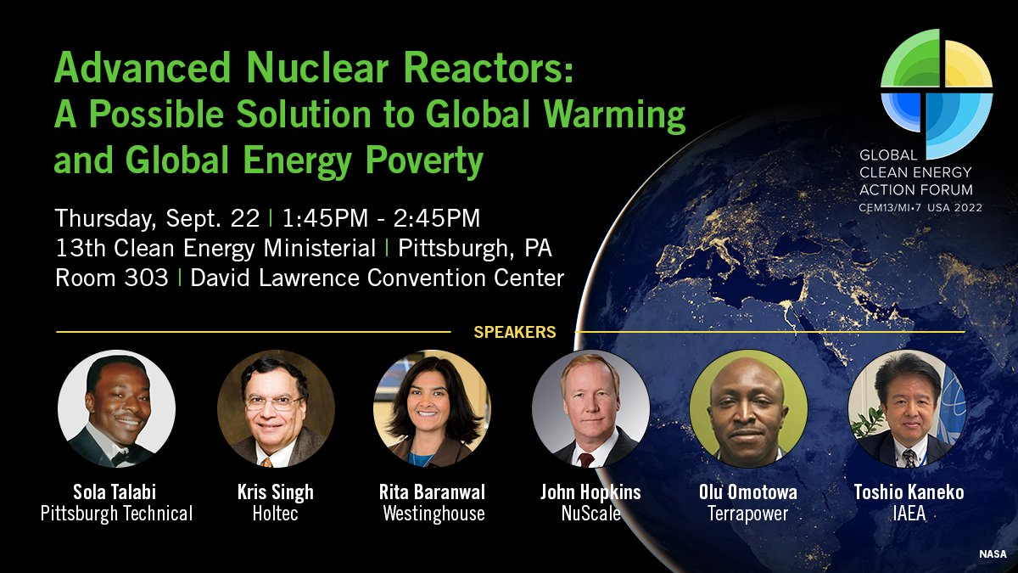
13th Clean Energy Ministerial and 7th Mission Innovation ministerial
Side event organized by ANS members Sola Talabi and Temi Adeyeye
Promoted by ANS to public and media

Slide 23
International Ministerial Conference on Nuclear Power in the 21th Century
Meeting with Nuclear Energy Agency and Canada’s nuclear waste management organization
Sessions on Fulfilling the promise, Enabling the Environment for wider development of nuclear energy, supply chain, inspiring youth, etc.

Slide 24
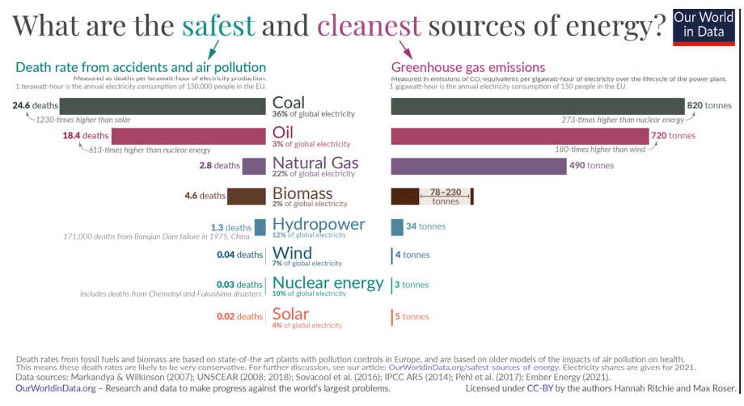
ANS at COP27
Nuclear For Climate advocacy in blue zone
Grassroots initiative of nuclear professionals and scientists from over 150 associations worldwide
European Nuclear Society, UK Nuclear Energy Institute’s Young Generation Network, and Generation Atomic
Advocacy and booth in blue zone
#NetZeroNeedsNuclear messaging at COP27
Signatory to Nuclear for Climate’s COP27 Position Paper, “The Fastest Path To Net Zero For A Sustainable & Energy Secure Future For All”

Slide 25
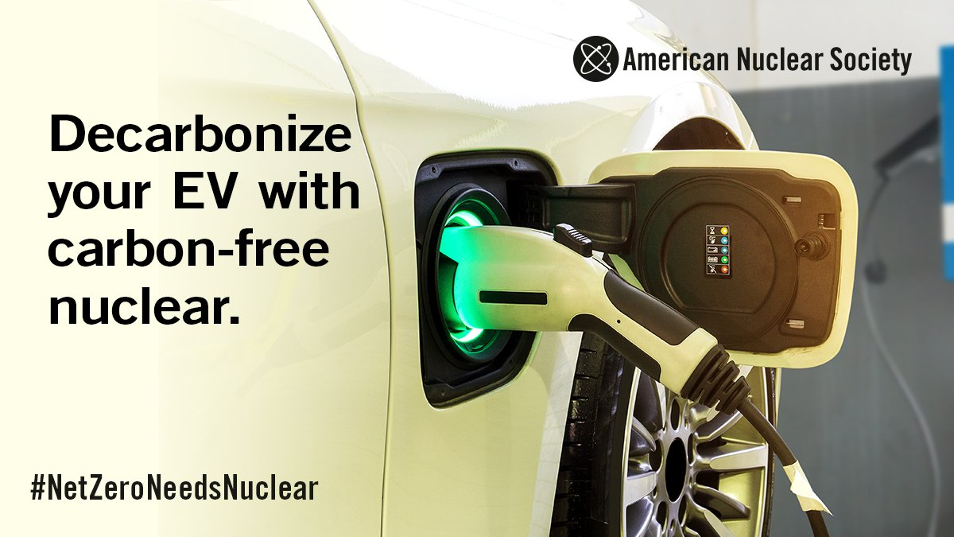
ANS delegates at COP27
ANS President participation on 1st week panel – “Live from COP”
2nd week, ANS-organized panel featuring ANS delegates, “Nuclear Power: The Robin Hood of Energy Exploitation” (combatting climate change and poverty)
ANS delegate on “Changing the game for climate - female leaders in the nuclear” panel with Katy Huff
In talks with DOE for additional panel
10 ANS members attending (Additional 2 spots for YGN)
N4C bluezone advocacy
#NetZeroNeedsNuclear messaging
Media interviews

Slide 26
Certification Program Goals
Provide nuclear professionals a means for learning and/or demonstrating knowledge
Different focus than nuclear professional engineering exam
Fill knowledge gaps between education and employer needs
Offer employees a standard means of qualifying candidates
Establish new products to advance ANS mission and generate revenue
Increase membership and meeting participation
Enhance ANS position in the industry

Slide 27
Certification Committee Scope
License
Permission granted by a competent authority to engage in a business or occupation or activity otherwise unlawful.
Certification
Authoritative attestation of meeting a standard.
Certificate
A document certifying that one has fulfilled training requirements.
Example: Professional Engineer
Examples: Project Management Professional (PMP), Certified Health Physicist (CHP)
Examples: University Certificate Programs, Coursera
PEEC Scope

Slide 28
Milestones & Schedule
Establish special committee
Market analysis (Jan–Mar)
Business Plan for Recommended Path Forward (Apr–May)
Begin Body of Knowledge Development (May-Jun)
Board Approval for Program Development (Jun)
Transition Standing ANS Committee (Jun 2023)
Job Task Analysis / Exam Specification (i.e., Blueprint) (Jul-Sept)
Exam Bank Development (Sept-Feb 2024)
Select vendor to administer exam (1Q24)
Pilot Exam / Cut Score (2Q24)
First Exam (by end of 2024)

Slide 29
Nuclear Power

Slide 30
Nuclear Power
A lot of great news
Investors, including venture capital
Bipartisan government support
New technology and new applications
Improved development and construction methods
Enhanced analytical tools
Heighten understanding of energy security

Slide 31
Characteristics of Advanced Reactors
More applications than just electric production
Simpler and safer (passive systems and inherent safety characteristics)
Increased safety margin
Lower potential for unsafe radiological release during accident
Lower proliferation risk
Smaller Emergency Planning Zones
Very low life cycle carbon emissions

Slide 32
Nuclear Power

Slide 33
Government Action
Inflation Reduction Act (IRA) Production tax credits
Up to $ 15 per megawatt-hour
Available for facilities in service in 2024 to 2032
Supports the Civil Nuclear Credit program in the Bipartisan Infrastructure Law
IRA Investment tax credits
From 6 percent to 30 percent
From 2025 to 2031 or when CO2 emissions fall
High-Assay Low-Enriched Uranium
IRA invests $ 700 million to support the development of a domestic supply chain

Slide 34
Proactive Support for Demonstrations
Advanced reactor demonstrations
TerraPower/GE-Hitachi Natrium sodium fast reactor with a molten salt energy storage system
X-energy Xe-100 HTGR, with matching investment from industry
Risk reduction awards
Kairos Power Hermes reduced-scale test reactor, a precursor of the company’s commercial fluoride salt-cooled high temperature reactor
Westinghouse eVinci, a heat pipe microreactor
BWXT Advanced Nuclear Reactor, a transportable microreactor
Holtec SMR-160, a LWR reactor
Southern Company Services Inc. Molten Chloride Reactor Experiment, a precursor to TerraPower’s Molten Chloride Fast Reactor

Slide 35
Small Modular Reactors
Examples
NuScale VOYGR
Design Certification
Utah Associated Municipal Power Systems (UAMPS), VOYGR-6 plant in Idaho is expected to be fully operational by 2030
Numerus other projects in development
Holtec SMR-160
US and Canadian design approval process
Potential siting at shutdown power plant locations

Slide 36
Dow goes nuclear
Nuclear power from small modular reactors should be a central part of the chemical industry’s drive toward achieving carbon neutrality said Jim Fitterling, chairman and chief executive officer of Dow Inc. at the International Pretrochemical Conference in March 2022
In August 2022, Dow announced that it will install advanced nuclear reactors at one of its Gulf Coast sites
Dow X-energy’s XE-100 HTGR

Slide 37
Other promising signs
West Virginia lifts ban on nuclear power plants, Illinois General Assembly is working on it
TRISO-X announced plan for fuel plant by 2025
U.K. energy strategy calls for new reactors
EU added nuclear to “green” technologies in taxonomy
Clean hydrogen hubs including nuclear
White house decadal vision for Fusion

Slide 38
Challenges
Nuclear Power
High capital cost
Infrastructure
Lack of research facilities and supplier infrastructure
Long construction times and availability of labor
Challenges with quality assurance
Long time frames for licensing
Nuclear fuel supply
Spent nuclear fuel
Consent-based siting

Slide 39
What needs to change?
Policy Level
Science-based policy
What does the science really tell us?
Linear-no-threshold model
Regulations on top of regulation
What are the real security risks?
Spent fuel repository / interim storage (how best to frame the debate)
Level playing field
Grid access
Life-cycle carbon emissions
Reduce the cost to be regulated

Slide 40
What needs to change?
Regulatory
Are we making our nuclear power plants “too safe to build”
Set the requirements based on the risk, not perception of risk
If we want an outcome, make that the metric
Only accept applications that can really be reviewed in two years both because the information is there, and the regulations are ready
Expect the regulator to be an expert (at all levels, from both perspectives)
Industry
Change the relationship with the regulator (and others)
Develop more realistic development paradigms
Become un-ashamed advocates for the technology

Slide 41
Advocacy for Nuclear Science and Technology How you can help

Slide 42
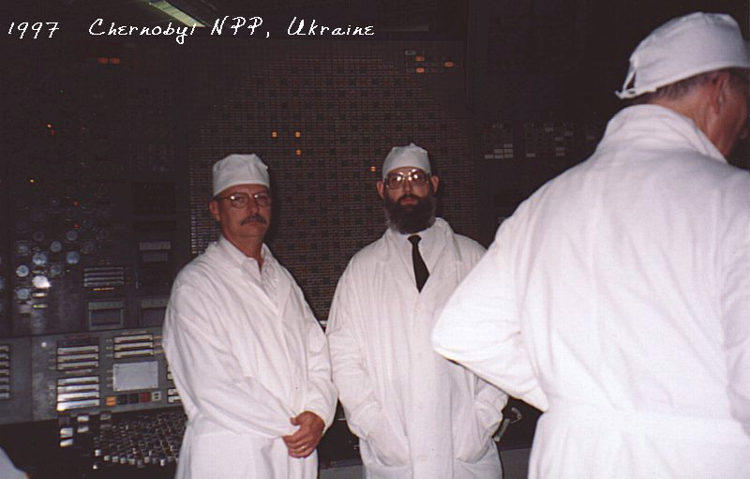
Advocacy for Nuclear Science and Technology
Take advantage of opportunities to engage with people outside the profession about nuclear technology
Does your passion come through?
Do you refer to respected third parties?
Make sure people know what nuclear science and technology is doing for them

Slide 43
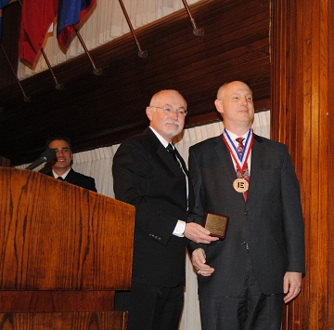
Advocacy for Nuclear Science and Technology
Be “known” outside the nuclear profession
Tailor your comments to your audience
Understand the difference between a conversation and a monologue
Listen well and encourage others to express their points of view

Slide 44
How ANS is helping
Our Past President Steve Nesbit and I have asked all the ANS Divisions to identify key technical and policy initiatives
We also need the support of the Local and Student Sections to help us identify issues, and develop positions
We are continuing to comment on key government policies and lend our voice to issues that need solving
We are working to educate, the public, government officials and the media

