Slide 1
Part 1. American Nuclear Society
Part 2. Nuclear, It’s Criminalization, and LNT

Slide 2
Mary Lou Dunzik-Gougar
President American Nuclear Society
Associate Dean College of Science & Engineering Idaho State University
18 November 2020

Slide 3
ANS Change Plan 2020
Continuing downward trend in membership and upward trend in budget deficit demanded change
Notes:
More explicit about what motivated the change plan, chart with revenue vs expenditures, provide evidence of reason for change, including decreasing membership, back up slide on 1ANS (what do successful societies do about membership?),

Slide 4
Membership Trends - Overall
Notes:
Dues increase in 2014 caused larger than expected attrition.
16% decrease in total membership from 2013-2019

Slide 5
Operating Deficits
Notes:
Dues increase in 2014 caused larger than expected attrition.
16% decrease in total membership from 2013-2019

Slide 6
ANS Change Plan 2020
Continuing downward trend in membership and upward trend in budget deficit demanded change
Change Plan 2020 developed by group of past Presidents and Board members
Board of Directors passed Change Plan in June 2019 and Implementation Plan in November 2019
Overall objectives
    More strategic fundraising and targeted spending to serve members
    Stabilize and grow membership numbers
    Improve member benefits (e.g. new member service center)
New Executive Director/CEO, Craig Piercy, hired late 2019
    HQ operational review January-February
    Reorganization/IT upgrades
Notes:
More explicit about what motivated the change plan, chart with revenue vs expenditures, provide evidence of reason for change, including decreasing membership, back up slide on 1ANS (what do successful societies do about membership?),

Slide 7
2020 Annual Meeting (June 2020)
COVID-19 pandemic required cancellation of in-person meeting (including hotel contract cancellation penalty)
Had to go virtual or go dark
Heroic staff put together completely virtual, very successful meeting
    More than 2300 registrants!
    Would have generated revenue, but for hotel contract cancellation fee
    Numerous institutions asked how we did it after the fact (e.g. HPS)
Plenary and technical sessions recorded for later viewing by registrants
Kudos to staff, who did all of this after an emotional reorganization and while working remotely due to COVID!
Notes:
Ask Paula about loss on annual meeting

Slide 8
2020 Winter Meeting (November 16-18, 2020)
Will be virtual and even better than June meeting!
Already more registrants than at this time before the June meeting.
3 big plenaries
  Opening plenary: unlike any before! Provocative and engaging. Alex Epstein, the moral case for nuclear power
  General chairs plenary (Paul Kearns, ANL Director and Bryan Hanson, Exec VP and CGO at Exelon): Nuclear science and industry: The next transformation
  President’s special plenary: As Low As Reasonably Achieveble? How reasonable are our dose regulations? What do we know about effects of low dose and how can we effectively communicate it?
Over 150 technical sessions
Notes:
Ask Paula about loss on annual meeting

Slide 9
Going forward . . .
Inward facing (members and societal function)
Dual mode (in-person/virtual) meeting organization
Continuing implementation of Change Plan 2020
Outward facing (members and the public)
Changing the way nuclear is viewed, starting by changing the way we, as members, think about nuclear
Notes:
Change the way YOU think about your technology, let’s talk about you, the ANS member, rather than the public

Slide 10
Part 2. Nuclear: Why the Resistance?
Nuclear energy has become the cleanest, safest, most reliable and scalable source of energy on the planet.
Even in the age of Climate Alarmism, nuclear is not considered THE answer . . . WHY????
Notes:
Anti nuclear protest graphic

Slide 11
Some quotes….
NASA
EPA
Although NASA’s main focus is not on energy-technology research and development, work is being done around the agency and by/with various partners and collaborators to find viable alternative sources of energy to power our needs. These sources of energy include the wind, waves, the Sun and biofuels.
Green Power Partnership
Coal, oil, natural gas, nuclear are “least beneficial” to the environment (interesting standard)
Solar, wind, geothermal, biogas, biomass, and low-impact hydropower are “most beneficial” to the environment
(https://www.epa.gov/greenpower/what-green-power)
https://climate.nasa.gov/solutions/adaptation-mitigation/
Notes:
Link to planet of humans

Slide 12
And not just government
Google
Amazon
Committed to buy “enough wind and solar electricity annually to account for every unit of electricity our operations consume, globally”
“Committed to using 100% renewable energy across our global infrastructure”
Supports 70 renewable energy projects
  Solar
  Wind
(https://sustainability.google/projects/announcement-100/)
(https://sustainability.aboutamazon.com/environment/sustainable-operations/renewable-energy)

Slide 13
And of course
Sierra Club
Greenpeace
“Ready for 100” campaign advocates for communities to commit to “transition to 100% clean, renewable sources of energy, like wind, solar, and battery storage.”
Recommends, “The path forward is an immediate halt to new oil, gas, and coal development in the U.S. and a managed phase out of existing fossil fuel production consistent with safe climate limits.”
https://www.sierraclub.org/ready-for-100
https://www.greenpeace.org/usa/reports/fossil-fuel-phaseout/

Slide 14
What’s going on? What’s behind the animosity?
Consider the environmentalist premise . . .
The natural world is good.
Changing the natural world is bad.
Humans change the natural world, so humans are bad.
Notes:
Supporting quotes

Slide 15
Premise evidenced by statements such as . . .
Humankind “would not rest content until the earth is covered completely, and to a considerable depth, with a writhing mass of human beings, much as a dead cow is covered with a pulsating mass of maggots” (Harrison Brown, The Challenge of Man’s Future in 1950)
https://www.forbes.com/sites/michaelshellenberger/2018/06/11/if-nuclear-power-is-so-safe-why-are-we-so-afraid-of-it/#3e1cd4c96385

Slide 16
Premise evidenced by statements such as . . .
Brown’s view was an extension of the ideas of 19th Century economist Thomas Malthus who lusted for the extermination of his fellow man, particularly the poor and the Irish. “Instead of recommending cleanliness to the poor,” Malthus argued, “we should encourage contrary habits…and court the return of the plague.”
https://www.forbes.com/sites/michaelshellenberger/2018/06/11/if-nuclear-power-is-so-safe-why-are-we-so-afraid-of-it/#3e1cd4c96385

Slide 17
Premise evidenced by statements such as . . .
Such anti-humanist ideas came full bloom in Stanford biologist Paul Ehrlich’s 1967 Sierra Club pamphlet, The Population Bomb, which depicted poor people in India as animals “screaming…begging…defecating and urinating.”
https://www.forbes.com/sites/michaelshellenberger/2018/06/11/if-nuclear-power-is-so-safe-why-are-we-so-afraid-of-it/#3e1cd4c96385

Slide 18
Premise evidenced by statements such as . . .
The small-world, zero-population-growth, soft-energy-path faction of the environmental movement that emerged across the 1960s and 1970s knowingly or unknowingly incorporated the antihumanist ideology of the neo-Malthusians into its arguments… “more power plants create more industry,” [the Sierra Club’s executive director complained,] “that in turn invites greater population density.” (From Richard Rhodes’ in Energy: A Human History, 2018)
https://www.forbes.com/sites/michaelshellenberger/2018/06/11/if-nuclear-power-is-so-safe-why-are-we-so-afraid-of-it/#3e1cd4c96385

Slide 19
Premise evidenced by statements such as . . .
”Our campaign stressing the hazards of nuclear power will supply a rationale for increasing regulation and add to the cost of the industry.” Sierra Club President (1974)
https://www.forbes.com/sites/michaelshellenberger/2018/06/11/if-nuclear-power-is-so-safe-why-are-we-so-afraid-of-it/#3e1cd4c96385

Slide 20
Premise evidenced by statements such as . . .
David Graber, biologist with National Park Service, “Human happiness, and certainly human fecundity, are not as important as a wild and healthy planet. I know social scientists who remind me that people are a part of nature, but that isn’t true. Somewhere along the line – at about a million years ago, maybe half that – we quit the contract and became a cancer. We have become a plague upon ourselves and upon the Earth. Until such time as Homo Sapeins should decide to rejoin nature, some of us can only hope for the right virus to come along.
https://www.forbes.com/sites/michaelshellenberger/2018/06/11/if-nuclear-power-is-so-safe-why-are-we-so-afraid-of-it/#3e1cd4c96385

Slide 21
Which stands in stark contrast to promise of nuclear
“Experts would be mobilized to apply atomic energy to the needs of agriculture, medicine and other peaceful activities. A special purpose would be to provide abundant electrical energy in the power-starved areas of the world.”
President Eisenhower, Atoms for Peace speech (1953)
https://www.forbes.com/sites/michaelshellenberger/2018/06/11/if-nuclear-power-is-so-safe-why-are-we-so-afraid-of-it/#3e1cd4c96385
Notes:
19th Century economist Thomas Malthus who lusted for the extermination of his fellow man, particularly the poor and the Irish. “Instead of recommending cleanliness to the poor,” Malthus argued, “we should encourage contrary habits…and court the return of the plague.”

Slide 22
But aren’t humans natural, too?
We are part of this world
We evolved over time, along with other species
However, different from other species, our evolution included developing the capability to reason, to think
THAT is why we thrive
We don’t have the physical attributes to thrive and nature doesn’t provide what we need to thrive
We understand and harness nature to create benefits
We thrive because we are able to “change nature”
Notes:
We evolved in nature and developed the ability to understand and use nature to thrive

Slide 23
“Changing nature” is what scientists and engineers do!
Harness otherwise useless resources and change them to make them useful (Alex Epstein, industrialprogress.com)
Extract coal/oil/natural gas and uranium to make electricity
Wind, solar and hydropower also not possible without resource extraction
  petroleum for wind turbines
  rare earth elements for solar panels
  iron for hydroturbines
Wind and solar not viable without backup from hydro, fossil, nuclear

Slide 24
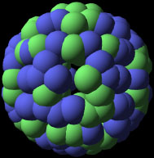



The anti-human flourishing worldview leads to . . .
Pressure to increase regulations
Associated litigation
The “criminalization of nuclear”*
  Nuclear is offensive to some because we understand and exploit the energy of the nucleus, the very foundation of all matter
Heat
Neutrons
(*Alex Epstein, Industrial Progress)
Notes:
Show picture of fission

Slide 25
If Mary Lou were Empress
(Disclaimer: not ANS views) . . .
No more subsidies for any kind of power production
  Get rid of “feed through tariffs” (guaranteeing above market price for renewable feed to grid)
Truly free energy market with consumer choice of power source and associated cost
  Get rid of “renewable portfolio standards” (requiring some % renewable)
Privatize nuclear waste management
Make regulations commensurate with risk, rather than based on Linear No Threshold (LNT) hypothesis, which is unsubstantiated for low doses at which we regulate, and As Low As Reasonably Achievable (ALARA)

Slide 26
Today, let’s focus on LNT/ALARA
Linear No Threshold hypothesis
  0 dose = zero risk
  Therefore 0 is the goal, because we want 0 risk (As Low As Reasonably Achievable)
Unsubstantiated at low doses
“Low-dose responses are non-linear at all levels of biological organization (molecular, cellular, tissue, organism) and suggest that LNT overestimates risk” (Tony Brooks, radiation oncologist)

Slide 27
LNT/ALARA
Though scientifically unsubstantiated at all but very high doses, still forms the basis for ALL nuclear-related legislation
Increased regulation → increased cost with no added benefit
  Regulated dose limit to general public from nuclear power must be less than 100 mrem/yr
  Our average dose from natural background is ~ 300 mrem/yr, with another ~ 300 mrem/yr from medical procedures
  Is this “reasonable”?
Notes:
Add numbers to support, quotes and DOE dose chart, costs money to go from natural background to lower than that, rather we could be spending money on things that help us thrive, eg COVID testing/tracing

Slide 28
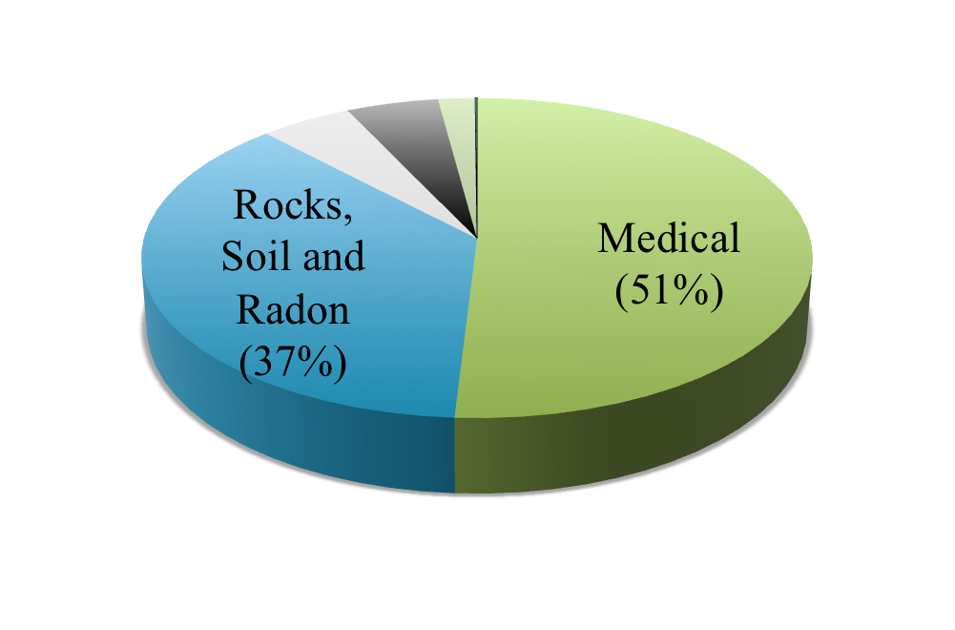
Sources of average radiation dose in the US
Consumer Products
(2%)
Cosmic
(5%)
Nuclear Power
(<0.1%)
Human Body
(5%)
The average
American receives a
radiation dose of 620 millirem per year.
Source: National Council on Radiation Protection and Measurement Report 160 (2006)
Notes:
The average
American receives a
radiation dose of 620 millirem per year.

Slide 29
LNT/ALARA
Though scientifically unsubstantiated, still forms the basis for ALL nuclear-related legislation
Increased regulation → increased cost with no added benefit
  Regulated dose limit to general public from nuclear power must be less than 100 mrem/yr
  Our average dose from natural background is ~ 300 mrem/yr, with another ~ 300 mrem/yr from medical procedures
  According to Health Physics Society, average person’s cancer risk from adding 50-100 mrem to annual radiation exposure is “not statistically different from zero”
Notes:
Add numbers to support, quotes and DOE dose chart, costs money to go from natural background to lower than that, rather we could be spending money on things that help us thrive, eg COVID testing/tracing

Slide 31
LNT/ALARA
Though scientifically unsubstantiated, still forms the basis for ALL nuclear-related legislation
Increased regulation → increased cost with no added benefit
  Regulated dose limit to general public from nuclear power must be less than 100 mrem/yr
  Our average dose from natural background is ~ 300 mrem/yr, with another ~ 300 mrem/yr from medical procedures
  According to Health Physics Society, average person’s cancer risk from adding 50-100 mrem to annual radiation exposure is “not statistically different from zero”
  Significant resources go into getting doses lower than natural background
  Is this reasonable?
Notes:
Add numbers to support, quotes and DOE dose chart, costs money to go from natural background to lower than that, rather we could be spending money on things that help us thrive, eg COVID testing/tracing

Slide 32
Minimization vs. Optimization
Minimization
Optimization
Unfortunately, ALARA has been interpreted and implemented as getting dose as low as possible
The intention of ALARA is for consideration of what is reasonable in an optimized radiation protection program

Slide 33
Case study: Impacts of implementing overly conservative dose limits, rather than considering reasonableness and optimization
Public | Dirty Harry weapons test (1953) | Fukushima accident (2011)
Regulated dose limit (mrem/yr) | 3900 | 100
Dose limit for considering evacuation | 250,000-500,000 mrem | 100 – 2000 mrem/yr
Max dose rate from event (mrem/h) | 340 | 4.5
Projected dose from event if no evacuation (mrem/yr) | 3000 | 1000 -5000
Dose impact | None | None
Other impact | Occasional “shelter in place” orders | Evacuation of > 100,000 people ~2300 deaths due to evacuation ~20,000 deaths due to earthquake & tsunami Significant mental/emotional strain
Bruce W. Church & Antone L. Brooks (2020): Cost of fear and radiation protection actions: Washington County, Utah and Fukushima, Japan {Comparing case histories}, International Journal of Radiation Biology, DOI: 10.1080/09553002.2020.1721595
Notes:
28 deaths at time of accident, 19 deaths over 20 years maybe caused by radiation

Slide 34
Why the difference?
Now
Lower dose limits for the public
Much more knowledge about effects of low dose (Tony Brooks, Radiation Oncologist)
  LNT is scientifically dead for low-dose risk assessment
  Radiation is a poor mutagen and carcinogen
  Low dose and dose rate radiation cancer risk is very small and very difficult to detect
  Fear of low dose radiation and radiation protection kills people and is very expensive
Then
Higher dose limits for the public
Less knowledge about effects of low dose
www.youtube.com/watch?v=If5msUhcOUQ
https://www.youtube.com/watch?v=UfS53M-KqwY
Notes:
demonstrated that the biological responses and the mechanisms of action following exposure for low doses are very different from the responses to high doses. Many of the low dose responses seem to be protective and may result in less biological damage than is observed in the controls. High dose responses activate a different set of genes and activate different proteins and metabolic pathways (Dauer et al. 2010) suggesting unique mechanisms of action as a function of both dose and dose rate. These observations do not support the use of the Linear No Threshold Hypothesis (LNTH) as being scientifically accurate. This sug-gests that the LNTH is not appropriate in making risk assess-ment and that using it over-estimates the risk in the low dose and dose rate region. Thus, science does not support the con-servative risk estimates, and especially the use of these esti-mates, in making judgments on actions to be taken following accidents, or other events where populations exposed to low doses delivered at low dose rates may result in drastic action

Slide 35

Current implementation of LNT and ALARA – an impediment to expansion of nuclear power and therefore inhibiting human flourishing
Historically, human life on earth is better than ever for many of us
Humans thrive when they have access to plentiful, safe, and reliable energy
Nuclear excels at all of these
Nuclear has become expensive for various reasons: one of them is regulation of potential radiation dose to levels well below natural background levels (adding considerable expense and no benefit)
Much of this is due to misinterpretation and misapplication of the ALARA principle (focusing on minimization instead of optimization)
Notes:
Cheap,reliable, abundant power is a human benefit. It’s up to others to show that radiation dose is a risk that overwhelms that benefit.

Slide 36
What can you and I do?
Alas, I am not the Empress
We understand why nuclear is not favored
  Let that understanding inform your interactions with those open to considering nuclear
We know that current LNT/ALARA practices are not reasonable
  Use your voice to communicate about the benefits of nuclear, the actual risk of radiation, and the need for optimization, not minimization
  Tell stories rather than cite statistics

