Slide 1

Climate Change (Emergency) and Nuclear Power
Vojin Joksimovich, PhD
American Nuclear Society
San Diego Chapter
June 17, 2020

Slide 2
101 on Climate Change (Emergency)
It is real, era of denialism seems over, ignore hysteria by climate jihadists, e.g. Greta Thunberg-person of the year, numerous political opportunists like AOC, globalists; facts there is global push to decarbonize
Greenhouse gases: mainly CO2 (lifetime 100 yrs), CH4 (12 yrs), N2O (114 yrs): 0.04% atmosphere; water vapor H2O (0.25% atmosphere, 2 weeks): make lower atmosphere nearly opaque to infrared radiation, though largely transparent to solar radiation; cause planet warming increase: Earth’s surface temperature from ~0F to 60F; human activities have strong effect
CO2 major sources: fossil fuels, deforestation, cement
CH4: natural gas primary component, leaks 2.3% of all it produces; ~10% US CO2 emissions, 25 times more potent than CO2 trapping earth’s heat
CO2/CH4/N2O released by electricity generation: ~40% of all industrial emissions; ~25% transportation: cars, trucks, trains, planes, ships; 9% steel industry; ~ 4% cement, fertilizers, plastics; mining, buildings
Known since 1860, Tyndall, however, nobody foresaw rapid fossil fuels growth
Known risks: Increasing sea levels, increasing hydrological events: droughts & floods, increasing incidence of high category hurricanes, storm surges & freshwater flooding, more heat stresses

Slide 3
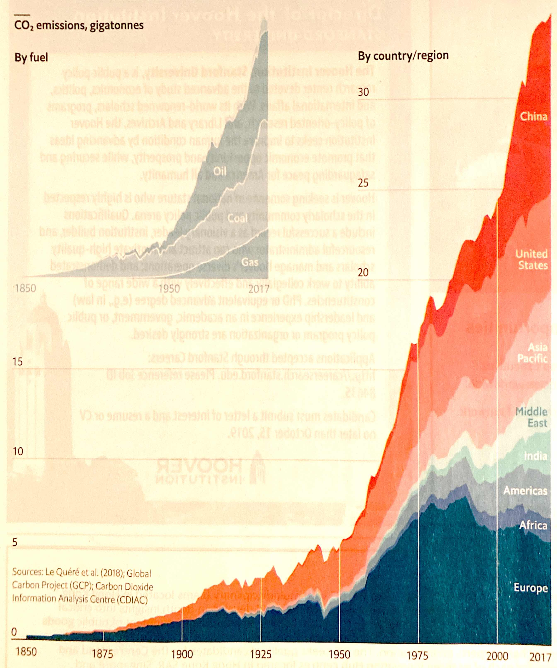
CO2 emissions, gigatons

Slide 4
UN Climate Change Conferences
1992 - Earth Summit Rio, established UN Framework Convention on Climate Change (CC)
Annual conferences since Berlin1995, 2 key ones
1997 - COP 3 failed Kyoto Protocol: voluntary arrangements, zero penalty tariffs, establish legally binding obligations for developed countries
2015 - COP 21 wobbly Paris accord: zero penalty tariffs, inducing free riders, agreement governing CC reductions
2019 - COP 25 Madrid, need for sharp emissions vs reduction outcomes; 2021 Glasgow-moved from 2020
UN’s Intergovernmental Panel CC (IPCC) has regularly issued reports since 1988; 2014 hundreds of possible scenarios; to me best climate model Russian INMCM5, predicting 1.4 C, at century end
2018 - IPCC Report of 1.5C to 2050; carbon removal for net negative emissions after 2050

Slide 5
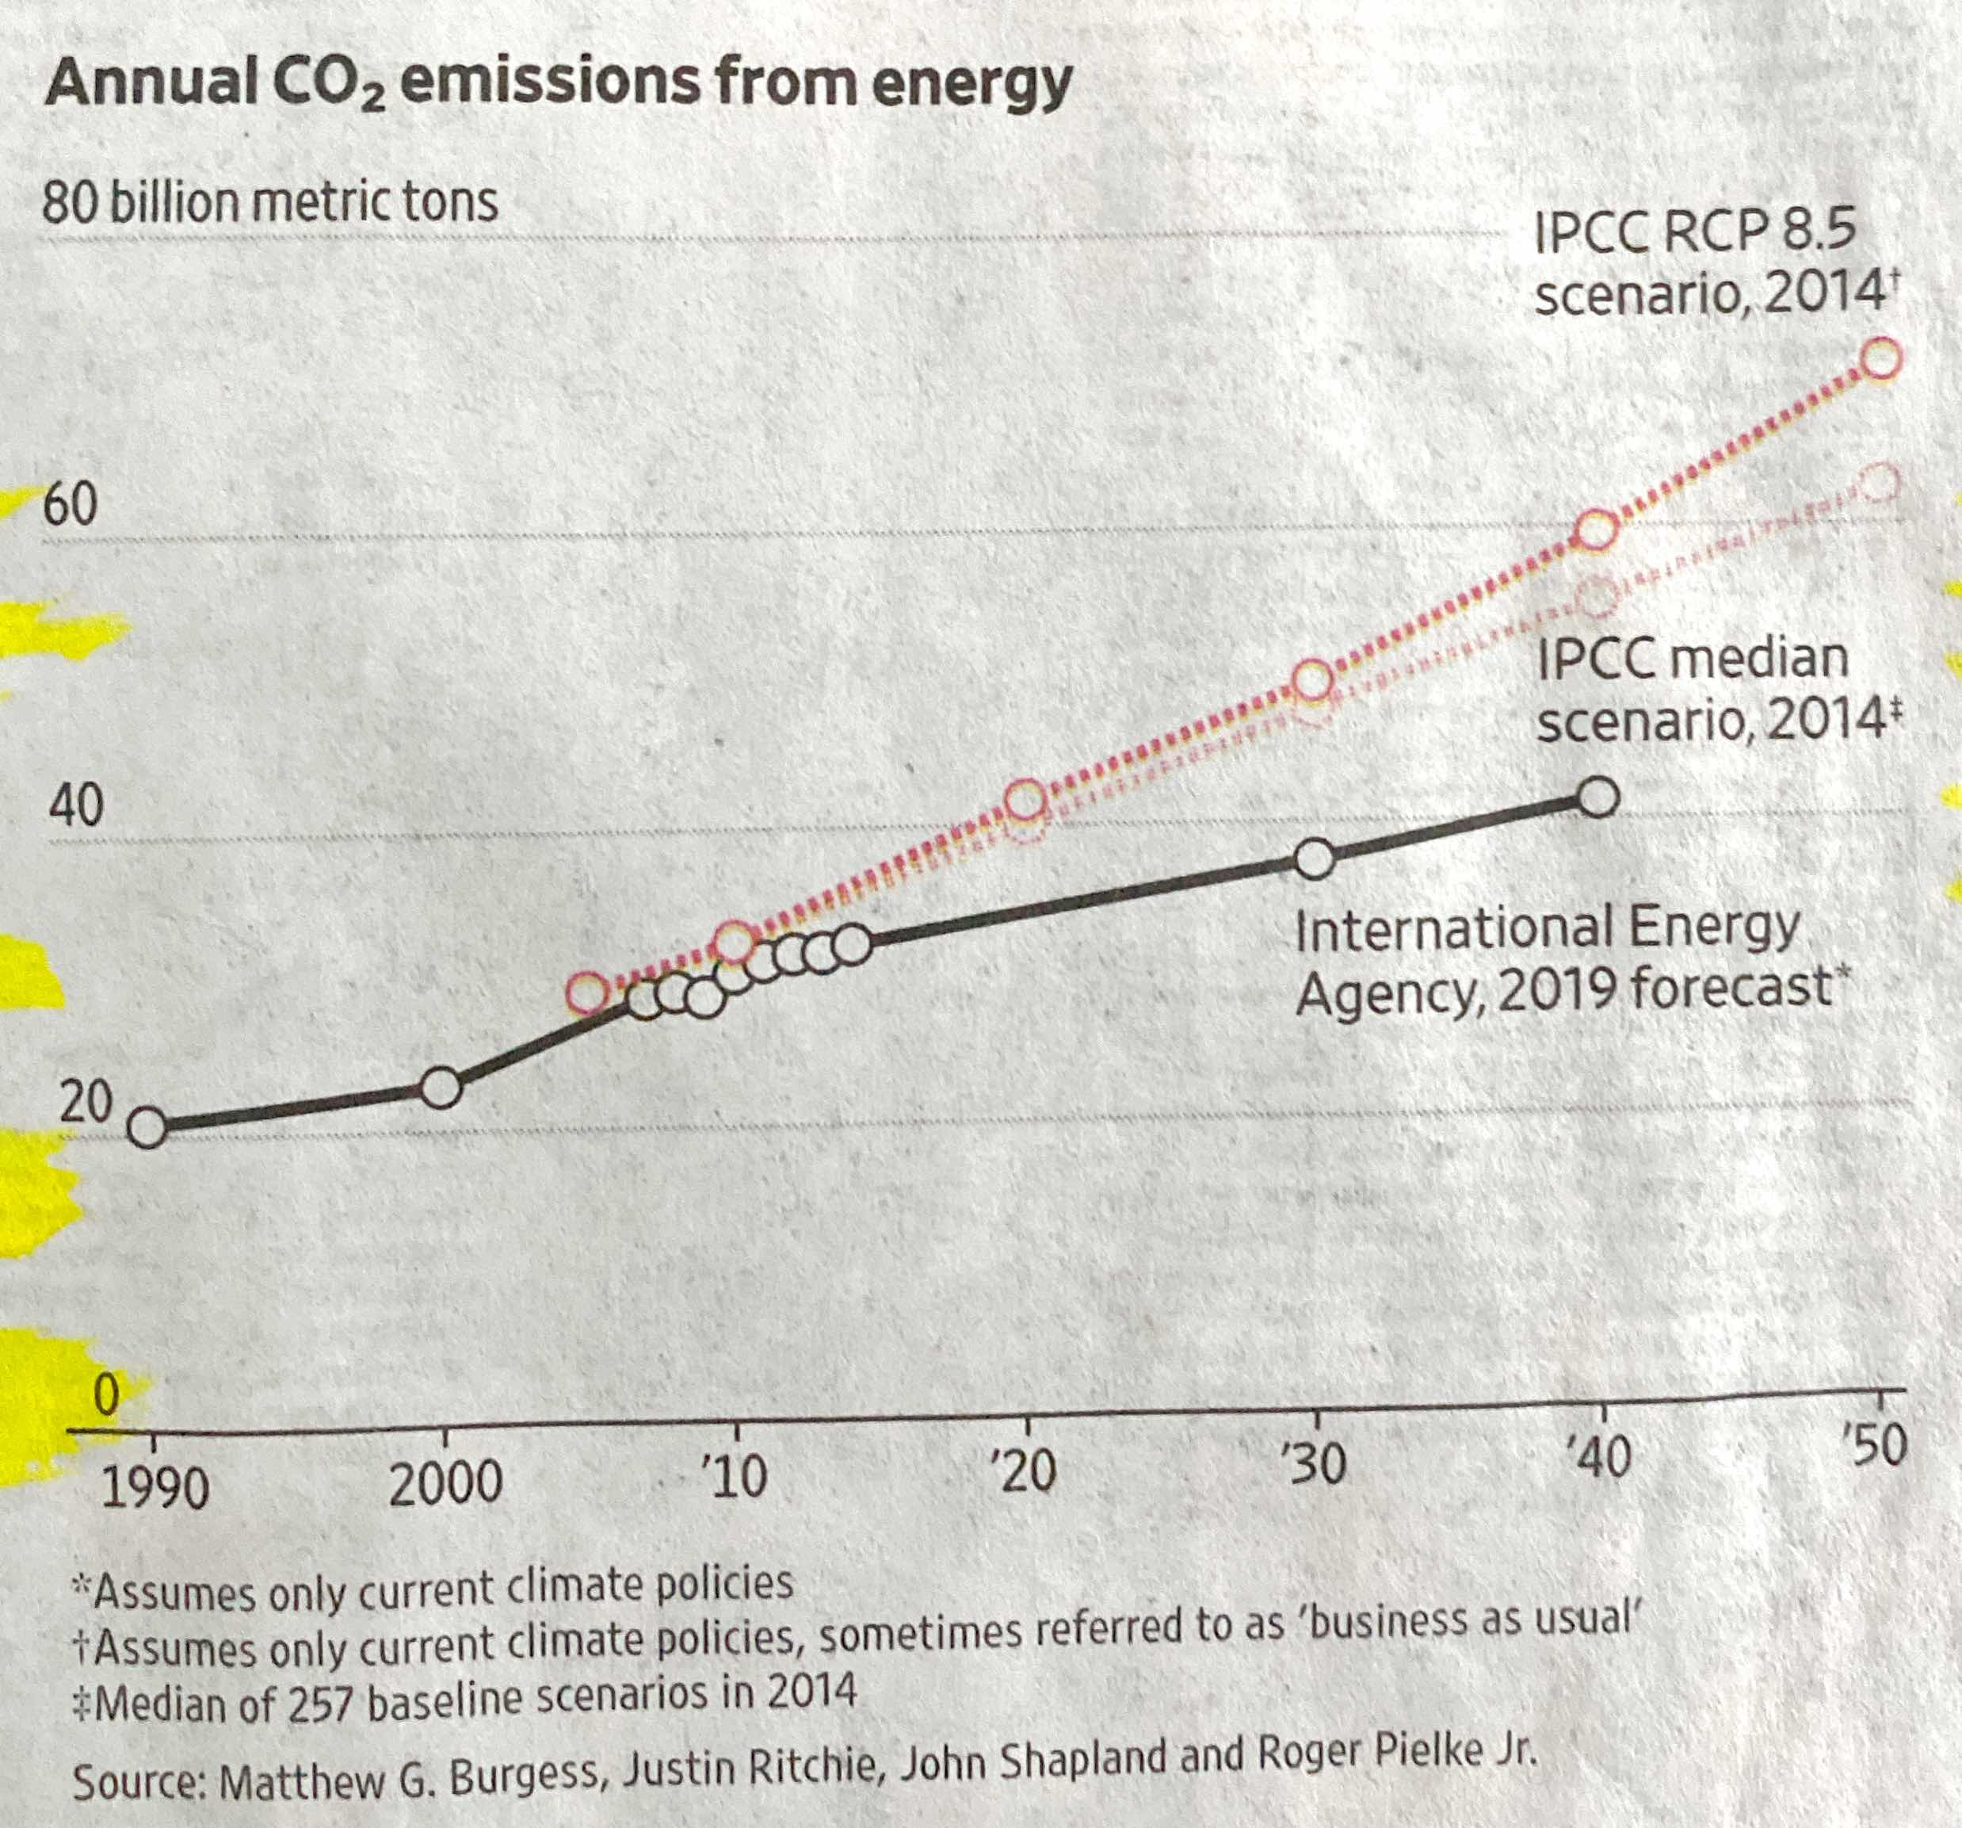
Annual CO2 emissions from energy

Slide 6
COP 21 Paris Agreement
2010’s hotter 0.5°C than in 1980s, mean surface temp ~1.1°C above preindustrial level, rising 0.2°C/decade, 0.5°C probably inevitable, much Arctic has seen >3°C
Targets, to prevent “dangerous climate interference;” promise to hold global warming “well below 2°C above preindustrial level, make efforts to limit temperature increase to 1.5°C, cost estimate 2.5% from world’s $86 trillion GNP/yr
Neither 1.5°C nor 2°C has any particular significance outside these commitments, not inhabitable world, harm warning: making extreme weather events, frequent and/or more intense changing patterns of rainfall and drought, disrupting ecosystems, driving up sea levels
195 countries pledged, entered force 11/2016, President Trump withdrew
Term net-zero means that every ton of greenhouse gas currently emitted (>43bn/yr) will be eliminated outright or offset, however, temperatures do not stop rising. IPCC 2019 requires 100bn-1trillion CO2 to be removed from atmosphere by century end
Extra gases accumulated over past two centuries will remain, removal from air necessary, chronic complexity involved

Slide 7
Global Status Snapshot
IEA: 2019 global CO2 emissions flatlined at 33 gigatons after two years of growth as world economy expanded by 2.9%; 15% coal decline in electricity generation in favor of renewables, nuclear; emissions in EU fell 5%, Japan 4%, rest of world grew by 400 million tons with 80% from Asia; Solar growth from142 GWe 2013-18 to 317 2019-24; India world’s cheapest solar energy producer: <$800/KW, 84% drop in 8 yrs, 40% non-fossil electricity 2030
Getting net-zero emissions by 2050 means halving emissions by 2030; lagging behind, no nation on course
UK: 2018 6% coal generation (from 44% in 2012), legislated massive cuts to net-zero emissions by 2050; by 2035 ending gasoline & diesel sales (France by 2040, Norway 2025)
EU Green Deal: $1.1T sustainable investments over decade, 2050 climate neutral, nuclear not green despite 126 nuclear plants provide >50% low C electricity; contested by Foratom, environmental groups, Poland); Germany: 2038 no coal, 2022 no nuclear; Greece shutting down coal plants

Slide 8
US Status Snapshot
Despite COP25 withdrawal, 2019 largest decline as country, fall 140m tons or 2.9%, emissions, down gigaton from 2000; consumed more renewables than coal as power generation source, first time since 1885
“If you put CO2 into atmosphere, your responsibility is to take it out” markets taking lead, not Fed Gov, numerous private industry initiatives; e.g. Microsoft: carbon negative by 2030, by 2050 plans to have removed from atmosphere all carbon it has produced since 1975 founding, establishing $1bn climate innovation fund for carbon reduction, capture & removal technologies; Amazon: 80% renewables by 2024, 100% by 2030, $10bn Bezos Earth Fund; HP $120m/yr fund; refiners invested $100bn/decade, some banks not loaning money for fossil fuel projects, e.g. drilling for oil in Alaska; Norwegian Sovereign Fund cut 4 Canadian oil companies
Utilities phasing out coal-fired generation, e.g. Consumers Power retired 7 plants, remaining 5 by 2040; 2020 TVA coal 12%, nuclear 43%; Southern Co (6 nuclear plants in operation, 2 under construction): net zero carbon by 2050, 50% reduction in carbon emissions from 2007 levels possibly by 2030; AES Corp: coal <10% by 2030, down from 34% last tear; 8 coal-mining companies went into bankruptcy

Slide 9
COVID-19 Pandemic Impact
Modelling for COVID-19 was fatally flawed, complex computer modelling of Climate Change might be even worse
Massively disrupted global economy, greatest shock to global energy system over seven decades
IEA 2020:100 days data, overall energy demand drop 7 times decline after 2008 crisis, -6% since 2019, -5% electricity demand drop; record fall in carbon emissions of ~8% vs. 2019; Nuclear off-track in Sustainable Development Scenario
US 2020: electricity demand drop to 17-yr low; 3% decline in power consumption
2020 investment collapse: 15% coal, 32% oil and gas, 10% renewables; major shift toward low carbon sources, i.e. wind, solar PV, hydro, nuclear: 40% of power mix
Hydrogen and battery storage stand out as two key technologies for decarbonization

Slide 10
Nuclear Generation Attributes/Drivers
2nd largest contributor to near carbon-free electricity after hydro (16% world electricity), Nuclear (10.6%); part and at core of clean energy future; averting emissions of 2.5bn CO2/yr; 64yr track record; provides base-load electricity, energy security, fights air pollution; wastes small vs. fossil fuel, medical isotopes & agriculture, capable of powering CO2 removal
Generating Electricity: from day 1 principal driver; even today 1/3 in India without electricity, 625m in Africa; Electric cars replacing combustion-engine cars worldwide; Chinese electric vehicle credit scheme-pays citizens to make switch
Non-Electric applications (not-available from renewables): desalination plants, industrial process heat, district heating
Innovations:
  SMRs, BWRX-300 in licensing
  US intends to restore leadership in Advanced Reactors: DOE $230m Demonstration Program, first step creating uranium reserve; National Innovation Center established
  SMR licensing harmonization: HTRs, integrated molten salt

Slide 11
Total Amount of CO2 plus other greenhouse gases emitted over full fuel cycle from extraction of raw materials through decommissioning in gCO2/kWh per UK House of Commons
Coal 823-1075
Oil 650
Natural Gas 411-440
Biomass 25-237
Photovoltaics 35-58
Marine 25-50:
Hydroelectric 3-10
Wind 4.5-5
Nuclear 3.5-5 (40% mining)

Slide 12
Mortality Rates: 100,000 deaths per trillion KWh (Kerry Emanuel)
Coal: Chinese 280,000
Global 170,000
US 15,000
Oil: 36,000
Natural Gas: 4,000
Biomass: 24,000
Photovoltaics: 440
Hydroelectric: 1,400
Wind: 50
Nuclear: 90

Slide 13
2019 WNA Global Status Snapshot
442 plants operating: generated 2563 TWh in 2018, 392.4 GWe (slightly less 2018); shutdowns outweigh startups,10 grid connections; 30 countries, 28 planning; 10.6% world electricity (coal ~39%, gas 23%, 7% wind + solar), 1/3 low carbon electricity; 53 underway ~60 GWe, 110 planned ~120 GWe, 330 proposed ~361GWe; three major concerns
WNA projection: Harmony Model: 20 C, 25% global electricity, 1000 GWe new builds by 2050
IEA: UN Sustainable Development Scenario: multiple strategies & innovations required; oil peaks 2020, down 73% by 2040, Nuclear increases ~90%, 678 GWe 2040
IAEA: 2030 low projection: 6% decline, high 25% up to 496 GWe, 80% to 715 GWe by 2050
Russia/China dominant; Russia technology/exports, China new builds; OECD countries hesitant; novices vital: e.g. UAE, Belarus, Bangladesh, Turkey, Egypt, Uzbekistan

Slide 14
Russia/China Status Snapshot
Russia: 38 operating, 203 TWh, ~29.2 Gwe; 18% electricity; life extensions 45-60 years; upratings 107-110%; 4 underway ~5 GWe; 24 planned, ~25.8 GWe; proposed 22.2 GWe; 225 TWh 2030, 260 TWh 2050 Post-Soviet exports $300bn-13 countries: 9 operating, 7 underway, 11 contracted,11 ordered, 30 proposals; N technology leader: VVERs, floating Akademik Lomonosov; fast reactors: “Proryv” closed fuel cycle, 2022 U-Pu MOX fuel in BN-800, decision for BN-1200 fast reactor
China: 48 operating plants 348 TWh (18% up), 48.74 GWe, 4.88% electricity;2019 example: Hongyanhe 4 CPR1000s, 30.76 TWh-avoided 9.48m tons of coal, 25.87m tons of CO2; 10 or 15 underway 11 GWe, 43 planned ~50 GWe, 170 proposed ~200 GWe by 2035; self-sufficient following use of Western & Russian technology; plan by ~2040 PWRs will level off, fast reactors progressively increase at least 200 GWe by 2050; exports: 2 operating +2 under way in Pakistan; goal 30 exports by 2030

Slide 15
Other Nuclear Leaders
US: 96 operating 808 TWh,~98 GWe, ~20% electricity, New Hampshire, S Carolina, Illinois generate >50% N; closing good plants (~10 imminent, Indian Point 2 closed in April), low natural gas prices; FP&L, Exelon, Dominion 80yr life extension; N renaissance fizzled, Vogtle 3&4 “unlikely” to meet May 2021/2022 in-service dates, $17 bn projected cost; no new plants until 2030, NuScale SMR in licensing, 2026 operation?
France: 58 operating 395.9 TWh, 63,13 GWe, 72% electricity, Flamanville 3 underway 1750 GWe, 6 EPRs for 2022 decision, 14 shutdown by 2035, Fessenheim 1/2 this year; 2020 EDF reduction to 300 TWh from 375-390 projected
India: 22 plants operating 35.4 TWh, 6.28 GWe, 3.1% electricity; 7 plants underway, 5.4 GWe; 14 planed 10.5 GWe, 32 GWe; sites for 28 plants approved, from 2020 plant/year to be commissioned
S. Korea: 24 operating 127.1 TWh, 23GWe, 27% electricity; 4 underway 5600 GWe, no planned, 2 proposed 2.8 GWe; exports: 4 in UAE; 40 yr phaseout?
UK: 14 AGRs, 1 PWR operating, 8.9 GW, ~20% electricity, 26 magnox reactors being decommissioned, 2 EPRs underway 3.26 GWe, 2 planned?
Japan: 2011 54 operating plants, 30% electricity, now 6.2%; 40 operable, 9 operating, 49.3 TWh, 17 restart approvals, 10 decommissioned, huge Daiichi cleanup costs; 2 underway 2756 GWe, 1 planned, 8 proposed
EU: 128 plants, 119 GWe, 26% electricity, 90% to be shutdown by 2035

Slide 16
Concern I: Severe Nuclear Accident
Three in 64year history:
    1979 – US, Three Mile Island (TMI-2)
    1986 – USSR, Chernobyl
    2011 – Japan, Fukushima Daiichi (FD)
TMI-2 B&W PWR: 45% core melt, small Radioactive Release (RR), GPUN bankrupt; $35bn NRC backfits; 30 yrs no orders
Chernobyl 4 Soviet RMBK-1000: 134 first-responder doses of >4000 mSv, 28 died in 3 months; Closure of Chernobyl units 1-3, Lithuania Ignalina, Bulgaria Kozloduy1-4, Slovakia Bohunice1-2
FD: GEJE induced tsunami flooded 4 TEPCO BWRs: 3 meltdowns, 3 hydrogen explosions, large RR <1/10 Ch, no health effects; ~$200 bn cleanup costs, slowed N development worldwide
Low public risk, risk to owners; 80% Gen II plants operating, new materials for cladding & fuel pellets: Accident Tolerant Fuel (ATF) testing in progress: Rosatom, GE, W, Framatome
1984 Bhopal, India: methyl isocyanate release;15-20,000 fatalities, ~half million health issues, site not cleaned up yet

Slide 17
Concern II: Massive Cost Overruns
After 64 yrs experience construction delays still causing massive cost overruns:
US never built nuclear plant on budget!
First-of-the-kind villains: US W AP1000s, French EPRs
2017: Westinghouse (Toshiba parent) filed Chapter 11 bankruptcy, emerged in 8/2018, Brookfield investors bought W for $4.6bn
Toshiba withdrew as N vendor: sold profitable memory chip unit, paid guarantees: to Summer 2&3 + Vogtle 3&4 owners; Summer 2&3 abandoned-no buyer found; Vogtle 3&4 saved by Southern Nuclear, operation 2021/22, total cost $27bn
French EDF Flamanville-3 & Finnish TVO EPRs, construction began 2007, fuel loading 2020/2022: cost ~trebled; $4.8 bn French government infusion & reorganization
4 Chinese W AP1000s (Sanmen, Haiyang) + 2 French EPRs (Taishan 1/2) after short delays now in commercial operation, Hinkley Point C EPR under construction in UK
Poland cannot afford to invests in first nuclear plants

Slide 18
Concern III: Political/Public Acceptance
TMI-2: US 35bn backfits + worldwide, partial phase-out in Sweden, Austria abandoned half built plant,
Chernobyl: Italy phaseout, pause in Russian program, several bans in Europe, Yugoslavia included, Australia
Fukushima Daiichi: $122bn impact, $12.6bn removal of 2-unit melted fuel; crippled nuclear program: NRA safety mandates implementation, decommissioning, e.g. TEPCO’s 15 units; irrational radiation/evacuation standards, local political & legal injunctions; instant wrongheaded shutdown of 8 plants in Germany + nuclear phaseout in 2022; no nuclear restart in Italy; gradual phaseouts in Belgium (2025) & Switzerland (2035); phaseouts in S. Korea?, Taiwan pro nuclear referendum ignored; Austria failed to turn neighbors against nuclear

