Slide 1
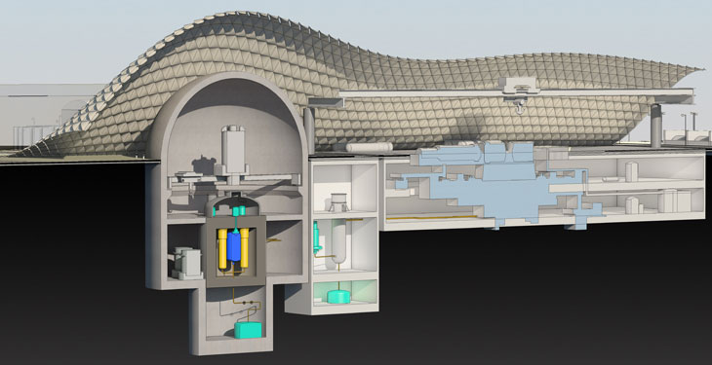
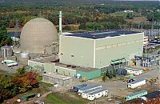
Make Nuclear Cool Again
Rick Perry, November 2019
Can We Afford Not to Recycle
Commercial Used Nuclear Fuel?
Steven Curtis, January 22, 2020
San Diego Section of the American Nuclear Society

Slide 2
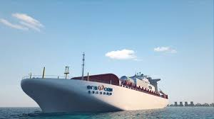
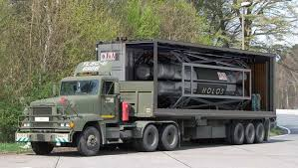
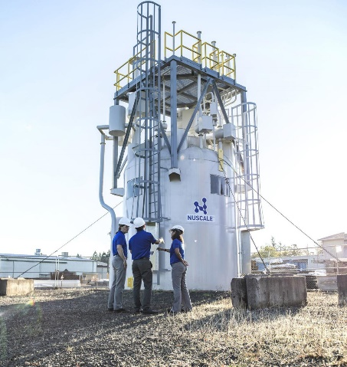
Ahh – Clean Air
Mobile Emergency
Power
Nuclear is the Power of the Future
Clean and Compact
Solid, Recyclable Waste Form
SMRs and Micro-Grids
Solar and Wind
Has Their Place
Not Base-load
Still Difficult to Integrate
Rooftop Installation Successful
Has Limitations
Difficult sell without subsidies
½ the life
1/3 Capacity Factor
Military Field and
Base Power
NuScale SMR
Prototype

Slide 3
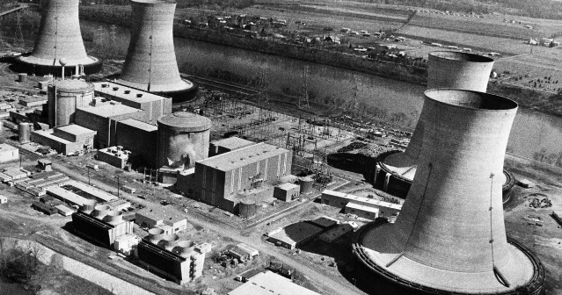
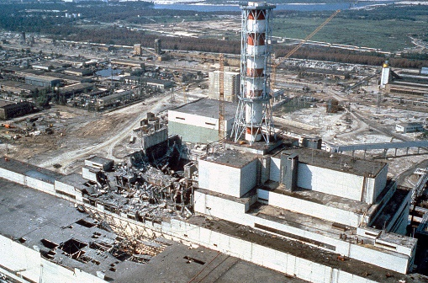
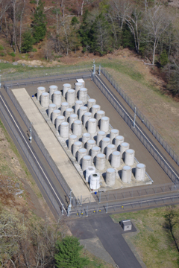
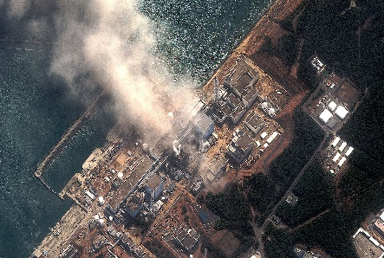
So, How Did We Lose Our “Cool”?
Three Mile Island
Chernobyl
Fukushima
Nuclear “Waste”
Sierra Club
“Costs Too Much”
No Strong Industry Leader
We Got Defensive

Slide 4
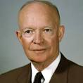
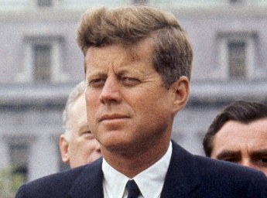
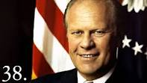
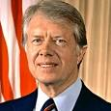
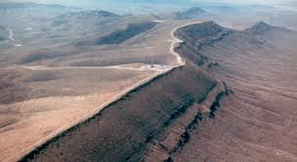
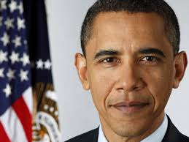
A Brief History – How Political Beat Scientific
Ike and JFK
Ford and Carter
Reagan
Harry Reid
Yucca Mountain
Obama
$13 Billion
$40 Billion

Slide 5
Recycling Commercial Used Nuclear Fuel
https://www.youtube.com/watch?v=MlMDDhQ9-pE

Slide 6
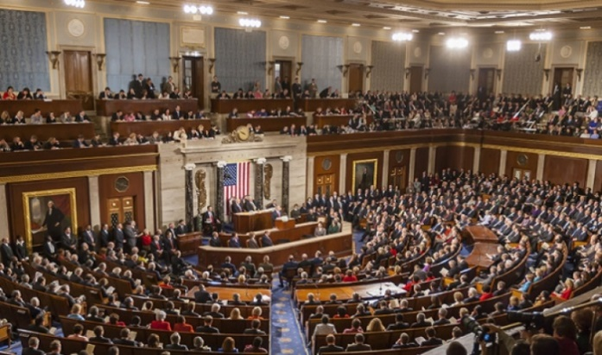
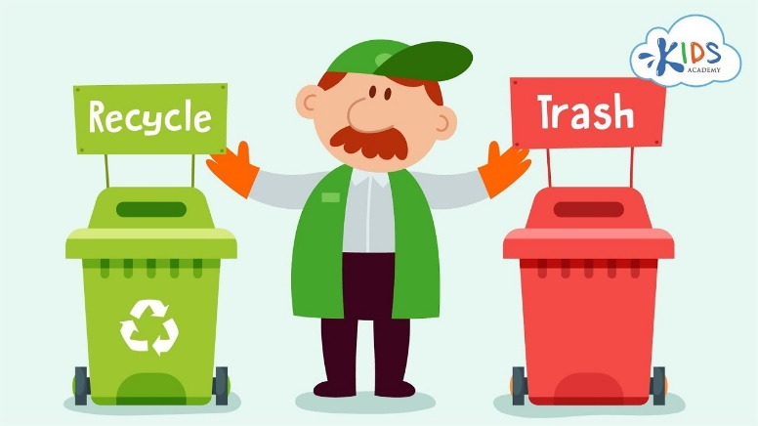
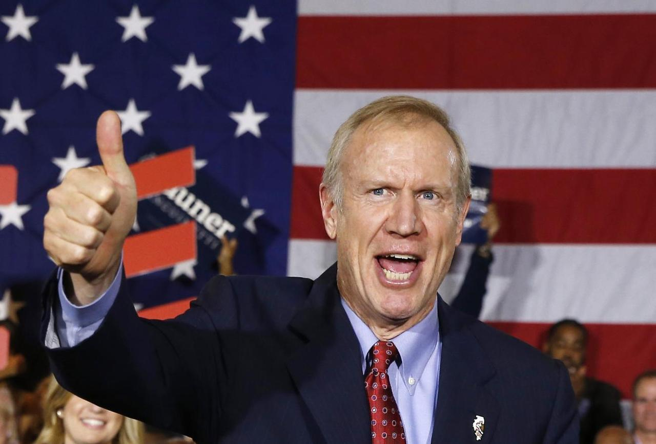
My Thought Process
43 Years of America’s brightest minds
No Implemented Solution
This is professionally embarrassing
Simplest part of the fuel cycle
What is the biggest impediment
People like “recycle” not “waste”
Let’s get a Governor to “Accept”
“The State defines what consent means”
“The State defines the benefits”

Slide 7
Why Would a Governor “Accept”?
Nevada fought the nuclear waste wars for 43 years
Ironically, until 1979, they were in favor of the Yucca Mountain Project
Something happened around 1980
Locals were in favor of this project, but no state has yet consented
Huge publicity against nuclear – almost none of it credible
Most people who have minimal education are in favor, but don’t care
A Governor would accept if it made him a hero in his state.
But, what makes a Governor a hero?
Big Economic Gain in High-Tech and Jobs.

Slide 8
Here’s Why Our Own Industry is Down on Recycling UNF
It’s too expensive
We already have an established
cheap pipeline for nuclear fuel
5% is mined in the United States
We will need a new pipeline for SMRs
Competition from Overseas
The mess at Savannah River – MOX
Richland, Washington
Is there really competition in the US?

Slide 9
Good Things About UNF Recycling
The nuclear industry pays up-front for waste treatment
If left up to industry the job would have been done
It is simply the right thing to do
$2.2M per day is the USG cost for waiting until tomorrow
Will be $1.25 B per year in 2022
France, India, Russia, UK, and Japan recycle. China will recycle
$40 Billion in a Congressional fund for recycling UNF

Slide 10
Benefits of Recycling
Recycling makes more sense to the general public
There are different ways to recycle UNF
Proliferation is not really a concern with recycling
Plutonium in UNF can be used as fuel
Next generation reactors will be very different
The US Government is desperate for a solution
Uranium is a valuable material
The cost for recycling is much less than burying
Do we really want to pass this issue onto the third generation?
Navy Nuclear fuel and depleted uranium can also be recycled
Competition in the world scene

Slide 11
Here is what you ask for
Benefit Negotiations (Figures are Annual):
Reprocessing Facility - $1.5B – 5,000 Jobs for a Century or more
Next Generation Reactors – Up to $1B per year revenue, 1000+ jobs
National Laboratory– minimum $2B per year in basic and applied projects, 5,000 jobs
Public/Private Business Opportunities – Technology Park - $1B
National Security Grid Research - $500M per year
Nuclear Powered Desalination Plant Direct to Nevada about $1B
Military Reactors – Prototype Site at Creech AFB - $1B
Total if All Initiatives Annual Impact: $8B, 20,000 jobs minimum

Slide 12
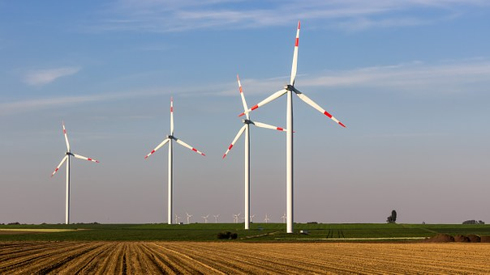
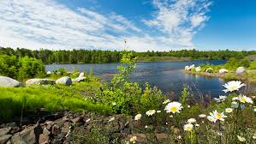
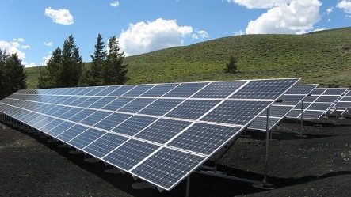
Clean Energy for a Clean Future
+
=

Slide 13
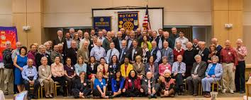
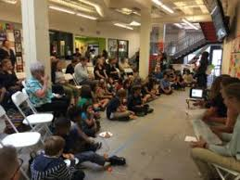
ANS Local Sections Have a Mission
Get the word out
Speak at Rotary, Lions, Kiwanis.
Get on the Radio
Host an Energy Forum
Become the Go-To Guys
Be Positive and on the Offense
Don’t get in the mud with antis
Tell people that it is their choice
Benefits, Benefits, Benefits!!!!
Write Letters and Op-Eds
Become the Nuclear “Answer Man”

Slide 14
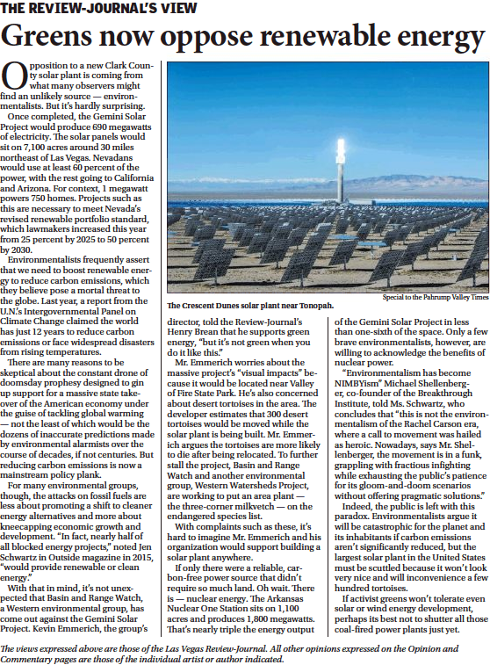
You Think Things are not Changing?
If only there were a reliable, carbon-free power source that didn’t require so much land. Oh wait. There is — nuclear energy. The Arkansas Nuclear One Station sits on 1,100 acres and produces 1,800 megawatts. That’s nearly triple the energy output of the Gemini Solar Project in less than one-sixth of the space.
Las Vegas Review-Journal Editorial
June 23, 2019
Notes:
The trend is starting and you the people have to pick up the gauntlet for this to happen.
Please ask your questions of either Bob Halstead, Bob List or me.
Thank you.

Slide 15
